Slide 1
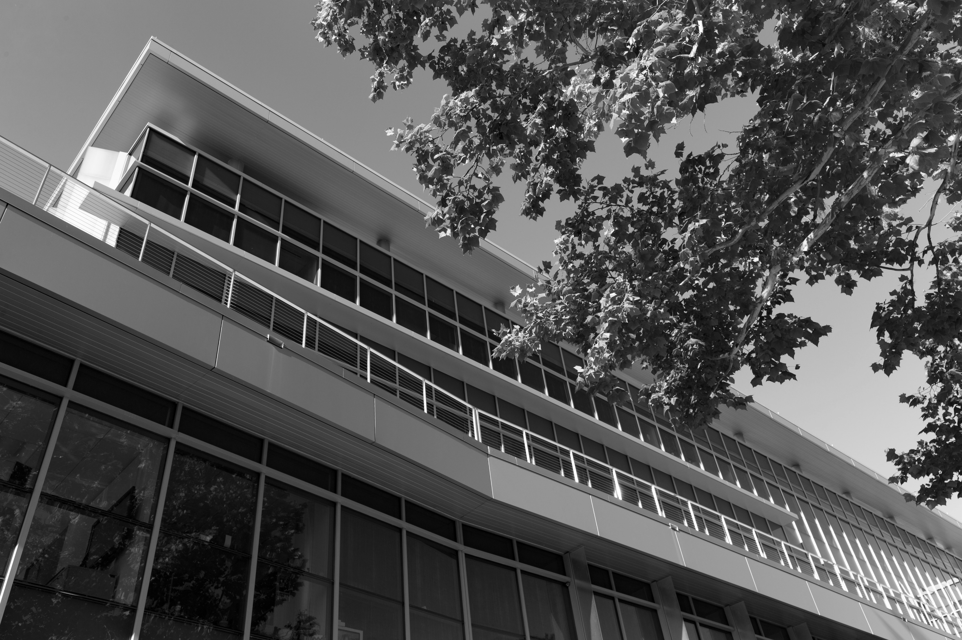

Comparing incentivization strategies for
cross-disciplinary collaboration
Outcomes at Arizona State University
and University of Florida
Christopher McCarty
Thomas Bryan Smith
Till Krenz
November 3, 2021
Research reported in this presentation was supported by the University of Florida Clinical and Translational Science Institute, which is supported in part by the NIH National Center for Advancing Translational Sciences under award number UL1TR001427.This content is solely the responsibility of the UF CTSI and does not necessarily represent the official views of the NIH.

Slide 2
What is cross disciplinary research?
Research involving researchers from two or more disciplines
Disciplines tend to reflect college and departmental administrative boundaries
Breaking down silos
The UF CTSI is supported in part by NIH Clinical and Translational Science Awards UL1TR001427, KL2TR001429 and TL1TR001428.
This content is solely the responsibility of the UF CTSI and does not necessarily represent the official views of the NIH.

Slide 3
Why cross disciplines?
The whole is greater than the sum of its parts
New areas of research or new solutions to existing problems may come from combining substantive knowledge or methods from two or more disciplines
Siloed disciplines may tend to yield siloed problems
Crossing disciplines may yield more productivity
Society may benefit from the impact
The UF CTSI is supported in part by NIH Clinical and Translational Science Awards UL1TR001427, KL2TR001429 and TL1TR001428.
This content is solely the responsibility of the UF CTSI and does not necessarily represent the official views of the NIH.

Slide 4
How universities incentivize collaboration
Centers and Institutes are typically places where researchers from different departments can come together around problems
  These may be less efficient as researchers are still bound to the day to day administrative and locational constraints of their departments
Seed grants and pilot awards are often structured around current problems or methods
  UF has recently offered many seed grants around both AI and racial equity
Cluster hires or other large faculty recruitment initiatives may incorporate a collaborative requirement across colleges
Collaboration events (Sometimes called Speed dating)
Less typical approaches
  Put people from different departments together in the same building (propinquity)
  Reorganize departments, schools and colleges around larger problems (the ASU approach)
The UF CTSI is supported in part by NIH Clinical and Translational Science Awards UL1TR001427, KL2TR001429 and TL1TR001428.
This content is solely the responsibility of the UF CTSI and does not necessarily represent the official views of the NIH.

Slide 5
Interdisciplinary Solicitations from Funding
NSF
  Dynamics of Coupled Natural and Human Systems (CNH)
  Smart and Connected Communities
  Research on Emerging Technologies for Teaching and Learning
NIH
  Collaborative Program Grant for Multidisciplinary Teams
  Social Epigenomics Research Focused on Minority Health and Health Disparities
  Hubs of Interdisciplinary Research and Training in Global Environmental and Occupational Health
DoD
  Multidisciplinary University Research Initiative (MURI)
The UF CTSI is supported in part by NIH Clinical and Translational Science Awards UL1TR001427, KL2TR001429 and TL1TR001428.
This content is solely the responsibility of the UF CTSI and does not necessarily represent the official views of the NIH.

Slide 6
Interventions at ASU and UF
Both universities have established centers and institutes, seed funding opportunities and cluster hires around topics
ASU reorganization began in 2003. There were two reasons for the reorganization
    Stimulate interdisciplinary collaboration around larger and more problem focused topics
    Eliminate redundancy that existed across several ASU campuses
A major UF intervention was the establishment of the CTSA in 2008
The UF CTSI is supported in part by NIH Clinical and Translational Science Awards UL1TR001427, KL2TR001429 and TL1TR001428.
This content is solely the responsibility of the UF CTSI and does not necessarily represent the official views of the NIH.

Slide 7
NCATS – NIH
Clinical and Translational Science Awards (CTSA)
Getting Science from Bench to Bedside
Translation NCATS definition: “the process of turning observations in the laboratory, clinic and community into interventions that improve the health of individuals and communities – from diagnostics, preventions, and treatments to medical procedures and behavioral changes.”
“…Program hubs that will be part of a national, collaborative consortium focused on bringing more treatments to more patients more quickly through advancing clinical and translational science (CTS) by…”
The UF CTSI is supported in part by NIH Clinical and Translational Science Awards UL1TR001427, KL2TR001429 and TL1TR001428.
This content is solely the responsibility of the UF CTSI and does not necessarily represent the official views of the NIH.

Slide 8
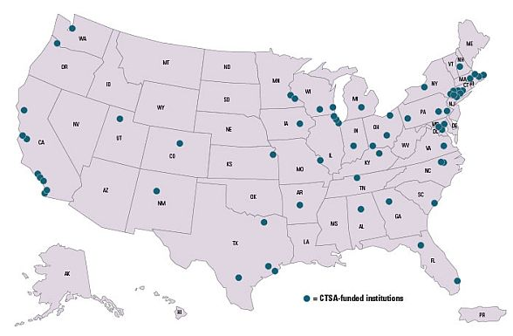
More than 50 CTSAs
The UF CTSI is supported in part by NIH Clinical and Translational Science Awards UL1TR001427, KL2TR001429 and TL1TR001428.
This content is solely the responsibility of the UF CTSI and does not necessarily represent the official views of the NIH.

Slide 9
CTSA Timeline at UF
First 12 CTSAs established in 2006
UF CTSA established in 2008 (grant for five years)
Renewal awarded in 2014 with Network Science as Optional Module
Second renewal awarded in 2018 keeping Network Science as Optional Module
The UF CTSI is supported in part by NIH Clinical and Translational Science Awards UL1TR001427, KL2TR001429 and TL1TR001428.
This content is solely the responsibility of the UF CTSI and does not necessarily represent the official views of the NIH.

Slide 10
Clinical and Community Translational Science at ASU
Deborah L. Helitzer, ScD
Dean and Professor
College of Health Solutions
Scott Leischow, PhD
Professor and Executive Director
Clinical & Translational Science
Affinity Network
Translational Team
(ANTT) Initiatives
CCTS Administration and Community Engagement
Clinical Translational Research
Recharge Center
CCTS
Clinical Services
Medical Oversight
Deb Williams, PhD
Clinical Asst Prof
CCTS Associate Dir
Sabrina Maham, PhD
CCTS Sr Dir
Theresa Jorgensen
Clinical Research Mgr
Latha Kannan, PhD
Research Lab Coord
Frank LoVecchio, DO Medical Director
TBN
Rsch Dietitian
Veronica Zamora
Rad Tech Sr
David Sklar, MD
Associate Medical Dir
Al Haddad
Proj Coord
TBN
Rsch Tech (gen)
TBN
Rsch Tech (ex sci)
TBN
Adv Practice Provider
Hire in process
TBN
Proj Coord
(hire in process)
TBN
Phlebotomist (0.5)
Lauren Shurson, DNP, FNP-BC
Edson College Partner
The UF CTSI is supported in part by NIH Clinical and Translational Science Awards UL1TR001427, KL2TR001429 and TL1TR001428.
This content is solely the responsibility of the UF CTSI and does not necessarily represent the official views of the NIH.

Slide 11
What we are about…
Foster knowledge networks to develop and optimize new methods of science, education, & practice: Affinity Networks
Support the implementation of research incubators dedicated to addressing significant health challenges: Translational Teams
Implement and optimize research structures and functions across the translational spectrum in the interest of improving individual and population health: Clinical and Community Translational Science Program
Foundational practices and principles:
  Community Engagement
  Dissemination & Implementation Science
  Education, Career Development, Training
  Health Equity and Inclusion
  Transdisciplinary and Team Science
The UF CTSI is supported in part by NIH Clinical and Translational Science Awards UL1TR001427, KL2TR001429 and TL1TR001428.
This content is solely the responsibility of the UF CTSI and does not necessarily represent the official views of the NIH.

Slide 12
Clinical and Community Translational Science - Background
2010: Community Oriented Network to Enhance Clinical Trials and Research (CONECTR)
-Alliance Agreement was executed between Arizona State University (ASU) and Quintiles, a contract research organization (CRO)
-Business model did not work out, and the initiative ended
2018: CHS CTSA strategic planning
-CHS faculty met for several months with intent to develop proposal to create CTSA-like infrastructure, including eval of multiple funded CTSAs
-Proposal to create infrastructure submitted to ASU Knowledge Enterprise
2019: Knowledge Enterprise consultants to assess ASU potential to develop CCTS infrastructure
-RECON consulting conducted interviews, surveys and market analyses – inc ROI evaluation
-Key recommendation they made for ASU was the creation of a Community Centered Clinical Core that would build on ASU structures/functions (eg Wexford) and foster collaborations with clinical partners, etc
2020: College of Health Solutions moves forward
-CHS has had an existing clinical infrastructure and recharge, and Leischow took over leadership to expand that infrastructure, inc reorganizing and expanding staffing, fostering collaboration with external partners, implementing research standards, expanding linkages across ASU orgs and research spaces
The UF CTSI is supported in part by NIH Clinical and Translational Science Awards UL1TR001427, KL2TR001429 and TL1TR001428.
This content is solely the responsibility of the UF CTSI and does not necessarily represent the official views of the NIH.

Slide 13
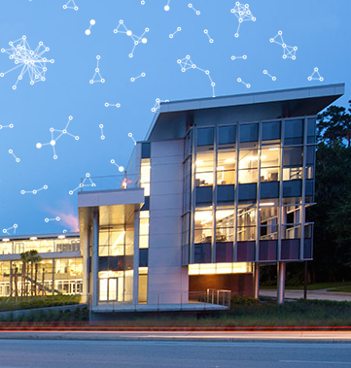
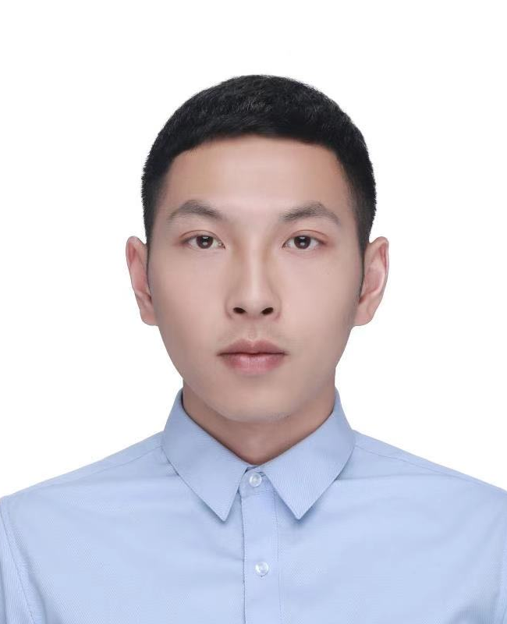



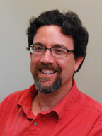
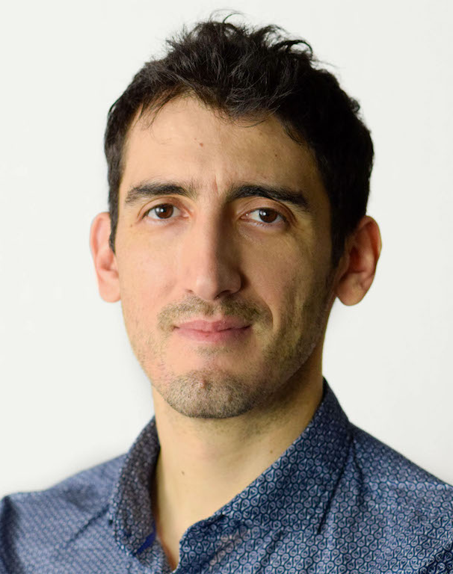
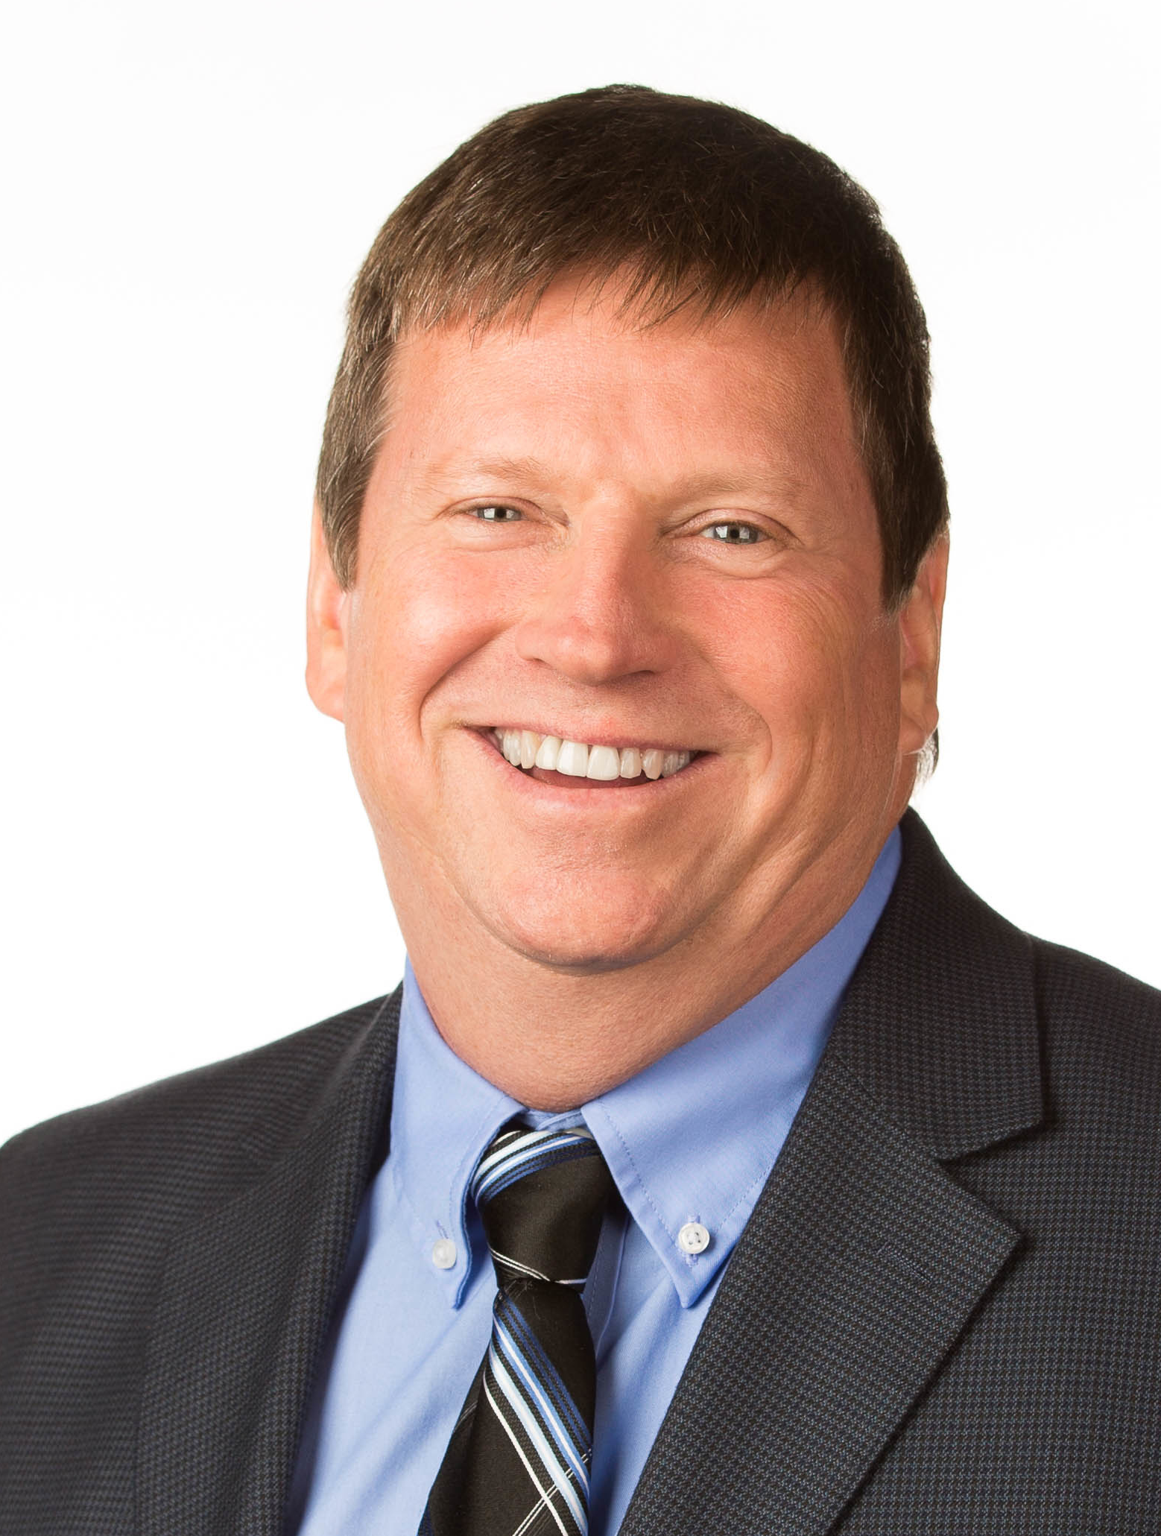
The CTSI Network Science Module (2018)
Network Science
Aim 1
Map emergent research communities in participating CTSA institutions
Aim 2
Evaluate the effect of CTSA programs on scientific collaborations and productivity
Aim 3
Identify cross-CTSA collaborative opportunities based on research topical maps

Slide 14
Network Primer
The UF CTSI is supported in part by NIH Clinical and Translational Science Awards UL1TR001427, KL2TR001429 and TL1TR001428.
This content is solely the responsibility of the UF CTSI and does not necessarily represent the official views of the NIH.

Slide 15
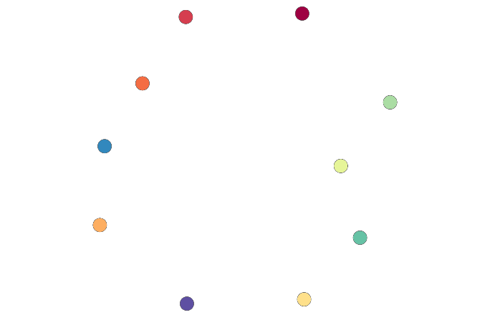
Individuals are nodes in a network
The UF CTSI is supported in part by NIH Clinical and Translational Science Awards UL1TR001427, KL2TR001429 and TL1TR001428.
This content is solely the responsibility of the UF CTSI and does not necessarily represent the official views of the NIH.

Slide 16
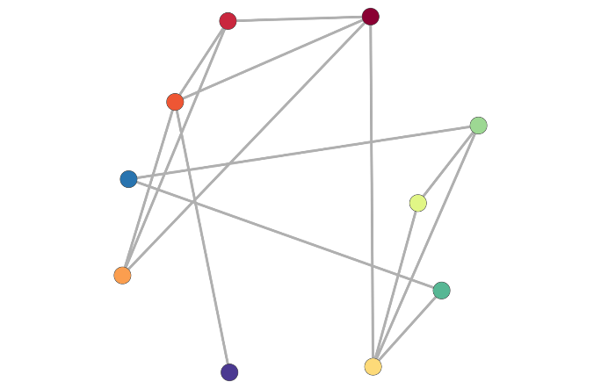
Interactions are ties
The UF CTSI is supported in part by NIH Clinical and Translational Science Awards UL1TR001427, KL2TR001429 and TL1TR001428.
This content is solely the responsibility of the UF CTSI and does not necessarily represent the official views of the NIH.

Slide 17
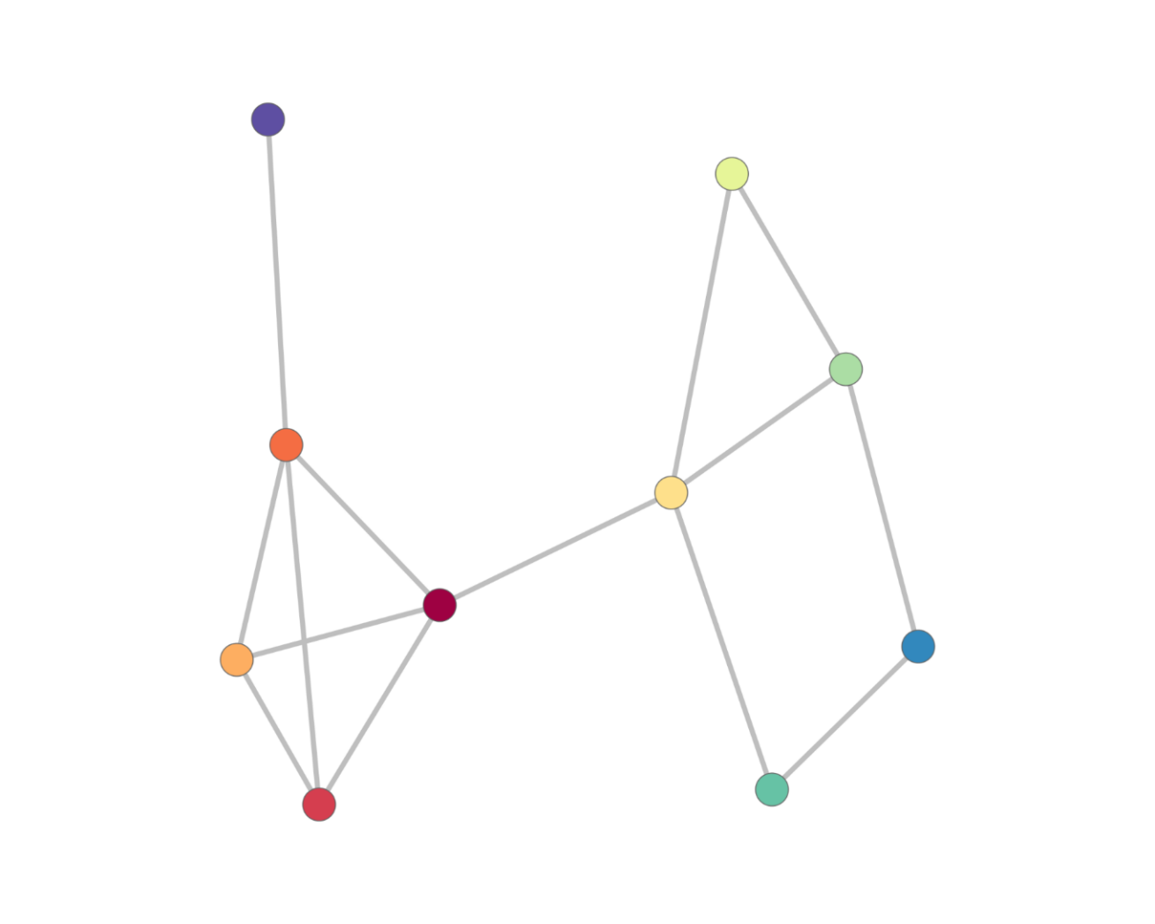
Nodes that are tied can be arranged so they are close to each other
The UF CTSI is supported in part by NIH Clinical and Translational Science Awards UL1TR001427, KL2TR001429 and TL1TR001428.
This content is solely the responsibility of the UF CTSI and does not necessarily represent the official views of the NIH.

Slide 18
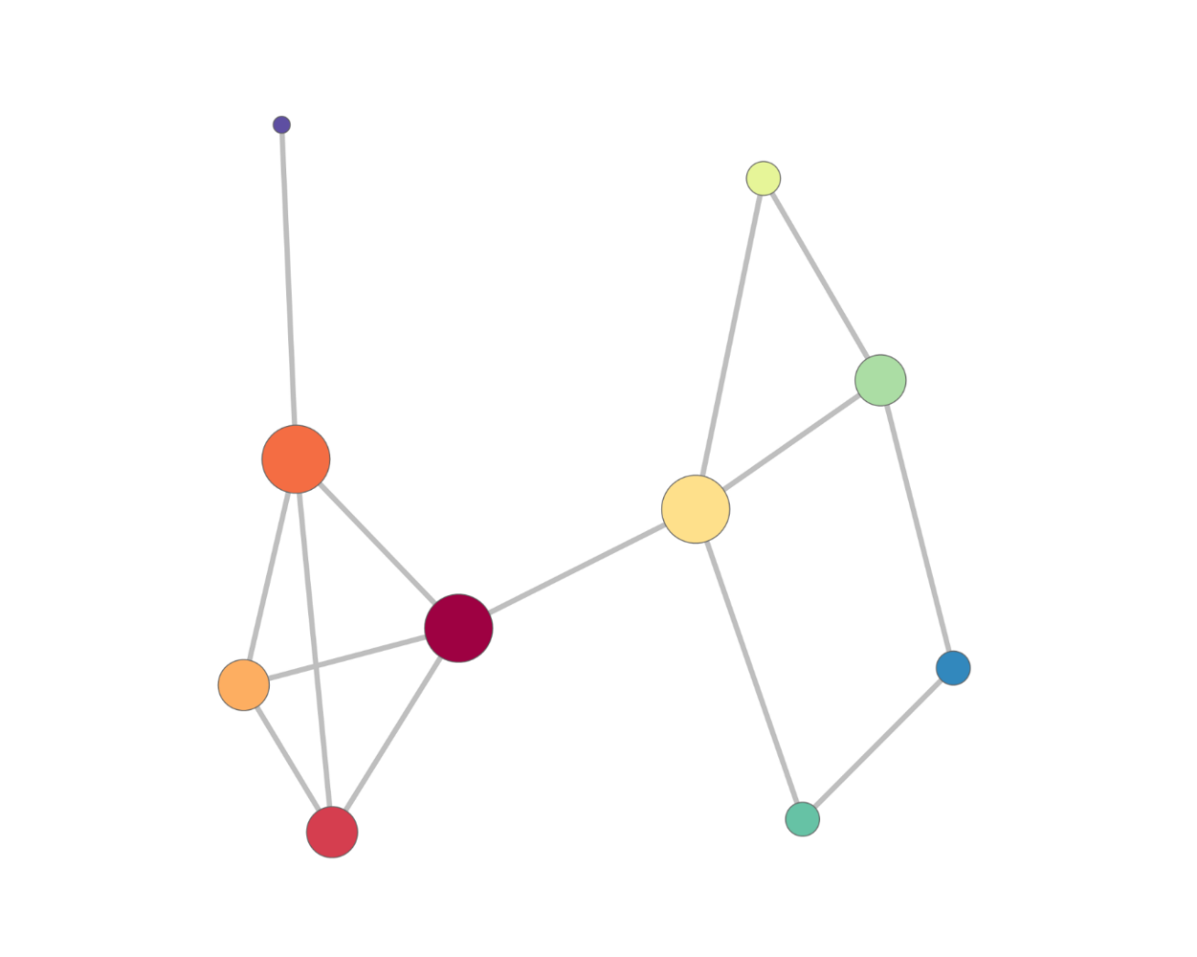
Once arranged nodes exhibit properties:
Degree centrality reflects direct ties
The UF CTSI is supported in part by NIH Clinical and Translational Science Awards UL1TR001427, KL2TR001429 and TL1TR001428.
This content is solely the responsibility of the UF CTSI and does not necessarily represent the official views of the NIH.
Notes:
18

Slide 19
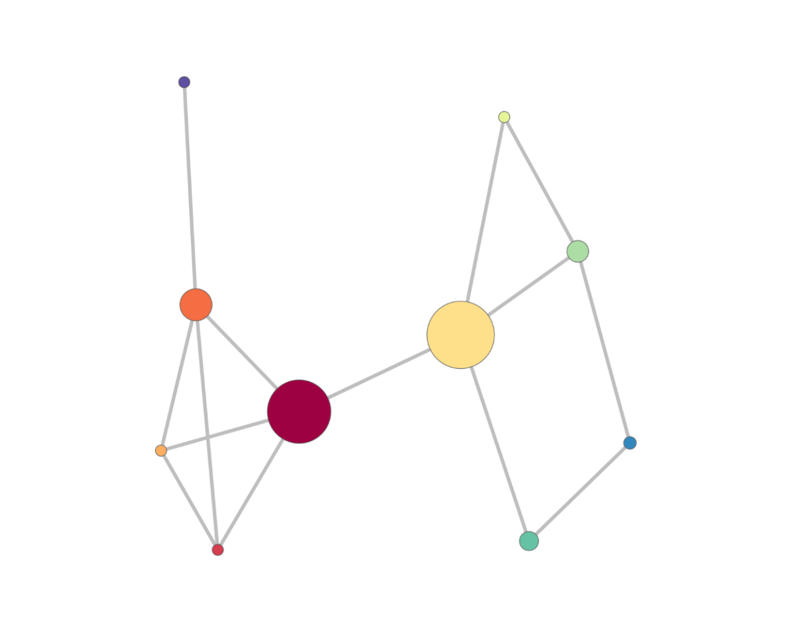
Betweenness centrality reflects brokering
The UF CTSI is supported in part by NIH Clinical and Translational Science Awards UL1TR001427, KL2TR001429 and TL1TR001428.
This content is solely the responsibility of the UF CTSI and does not necessarily represent the official views of the NIH.

Slide 20
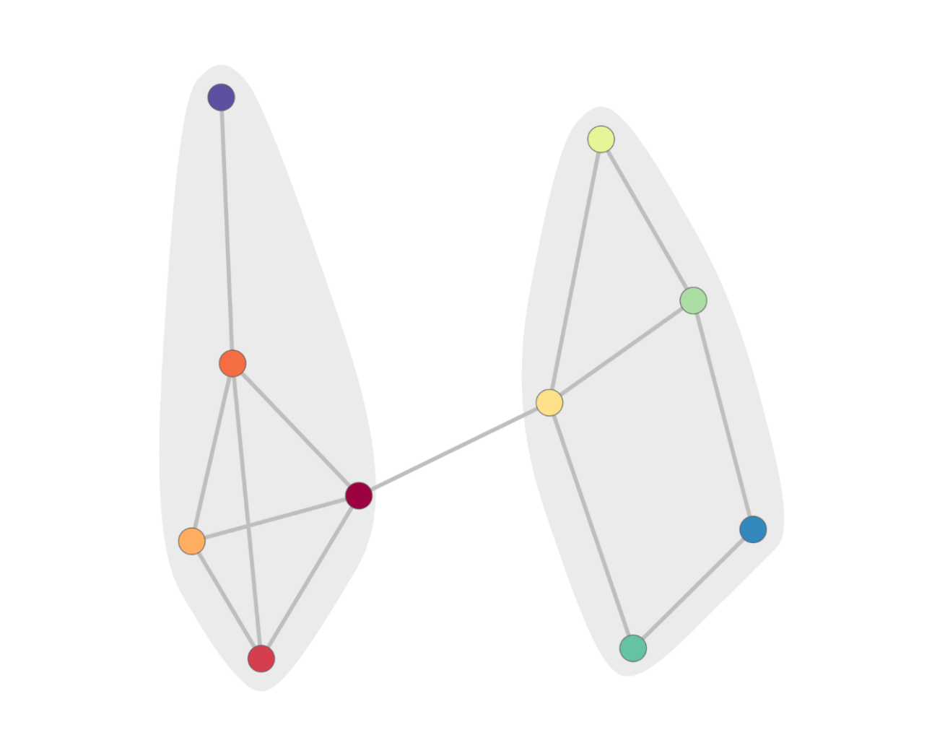
We can also detect communities
The UF CTSI is supported in part by NIH Clinical and Translational Science Awards UL1TR001427, KL2TR001429 and TL1TR001428.
This content is solely the responsibility of the UF CTSI and does not necessarily represent the official views of the NIH.

Slide 21
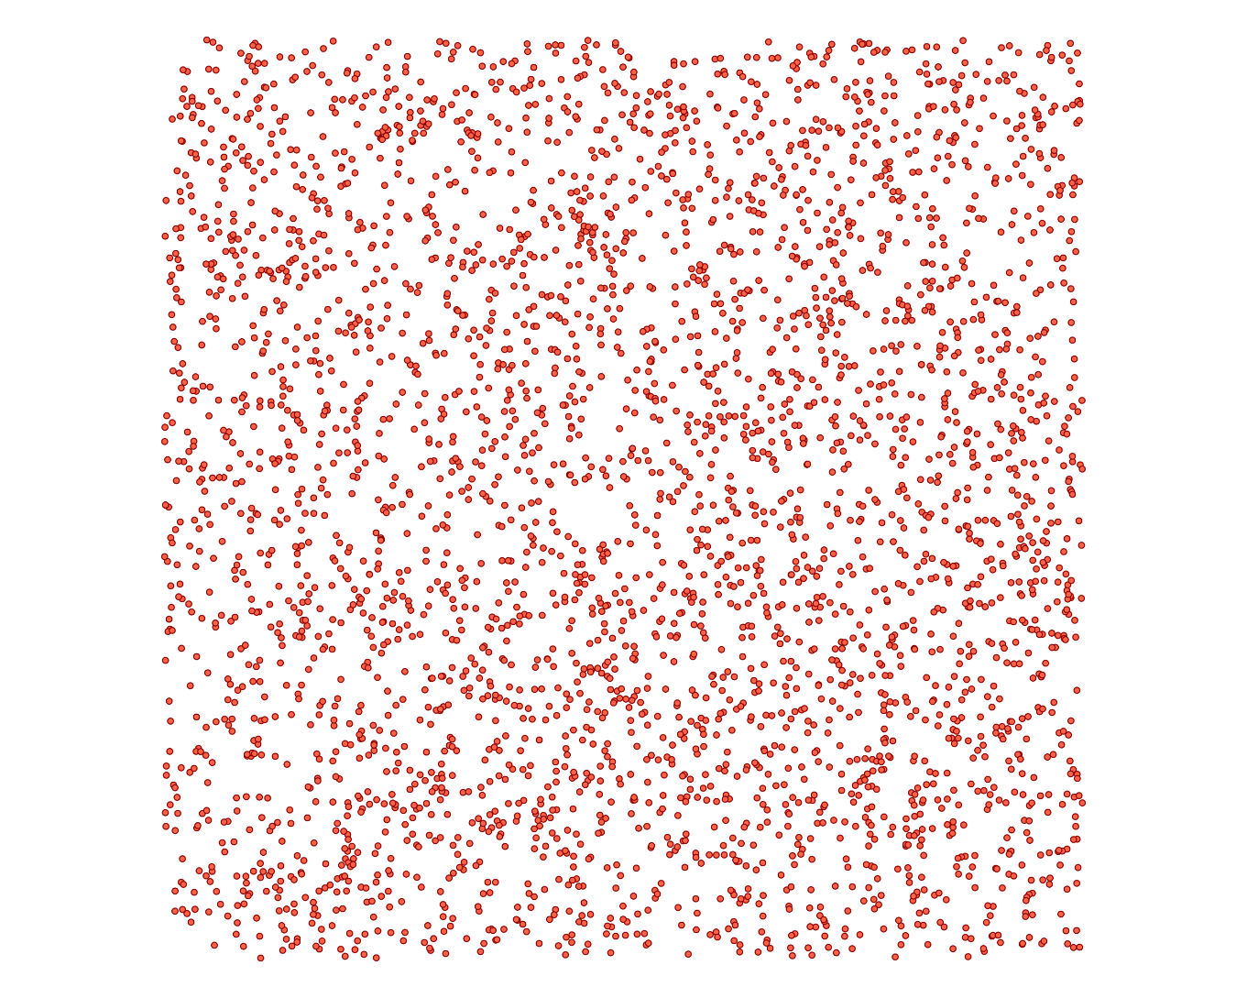
Nodes at UF can be authors
The UF CTSI is supported in part by NIH Clinical and Translational Science Awards UL1TR001427, KL2TR001429 and TL1TR001428.
This content is solely the responsibility of the UF CTSI and does not necessarily represent the official views of the NIH.

Slide 22
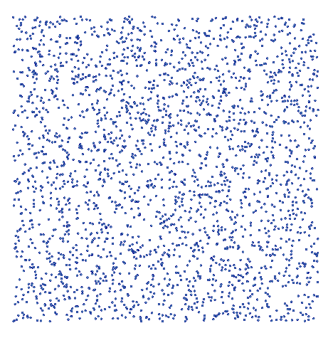
…or grantees
The UF CTSI is supported in part by NIH Clinical and Translational Science Awards UL1TR001427, KL2TR001429 and TL1TR001428.
This content is solely the responsibility of the UF CTSI and does not necessarily represent the official views of the NIH.

Slide 23
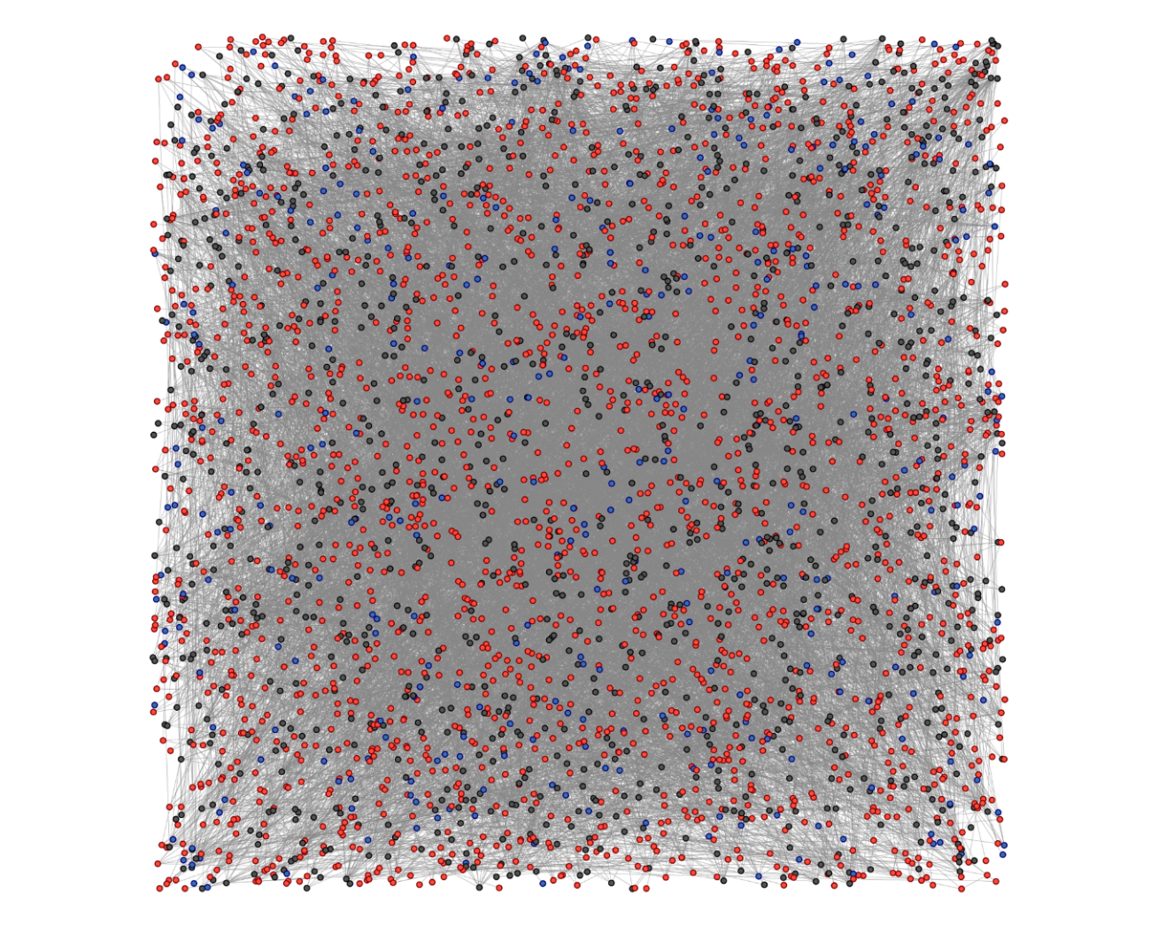
Grantees and authors collaborate
The UF CTSI is supported in part by NIH Clinical and Translational Science Awards UL1TR001427, KL2TR001429 and TL1TR001428.
This content is solely the responsibility of the UF CTSI and does not necessarily represent the official views of the NIH.

Slide 24
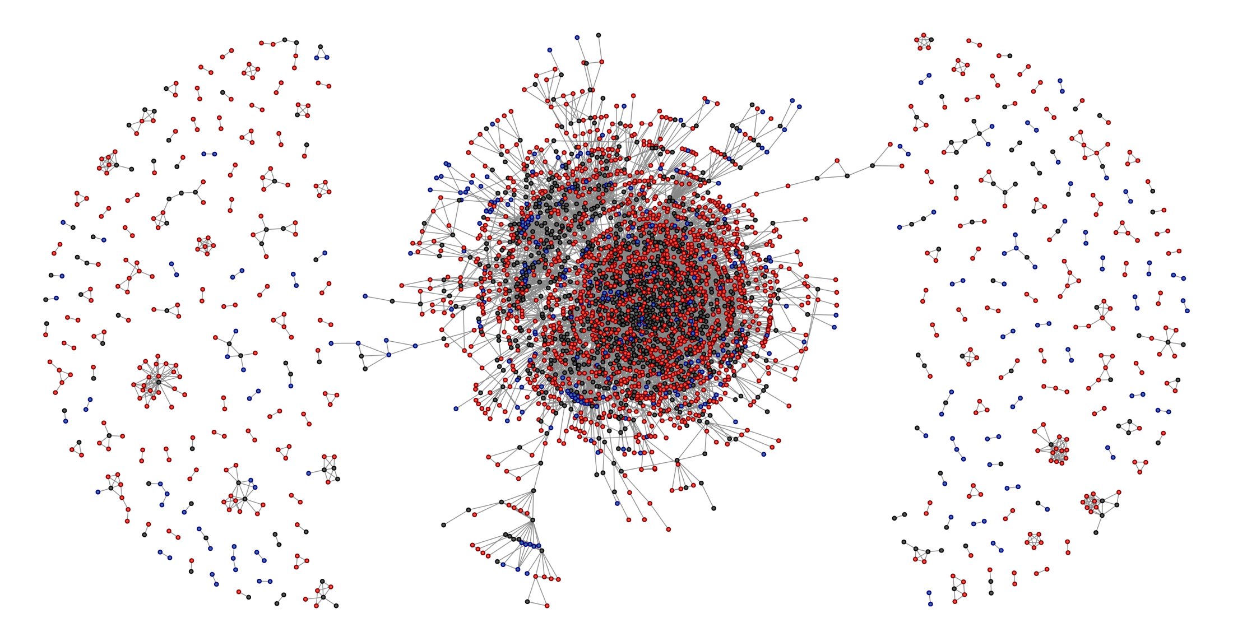
…and can be arranged like this
Publication author
Grant investigator
Both
The UF CTSI is supported in part by NIH Clinical and Translational Science Awards UL1TR001427, KL2TR001429 and TL1TR001428.
This content is solely the responsibility of the UF CTSI and does not necessarily represent the official views of the NIH.
Notes:
24

Slide 25
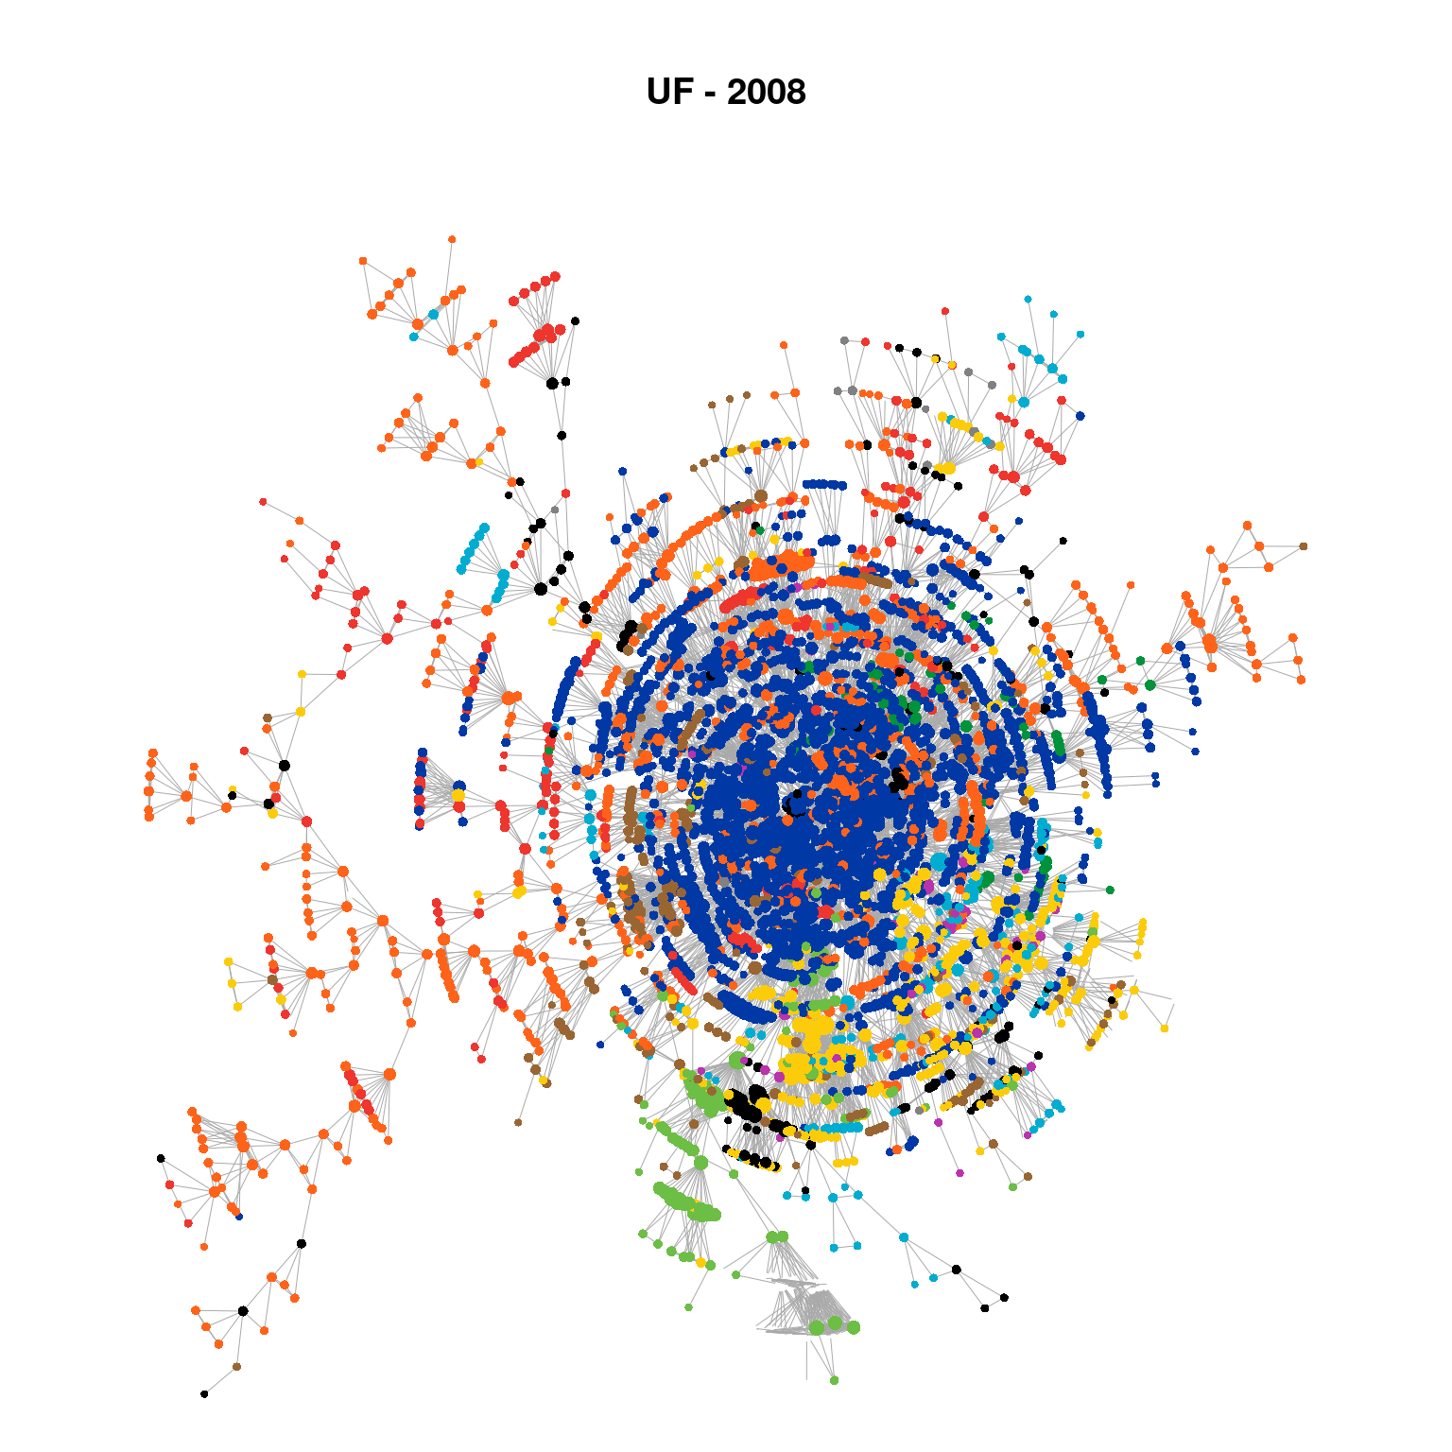
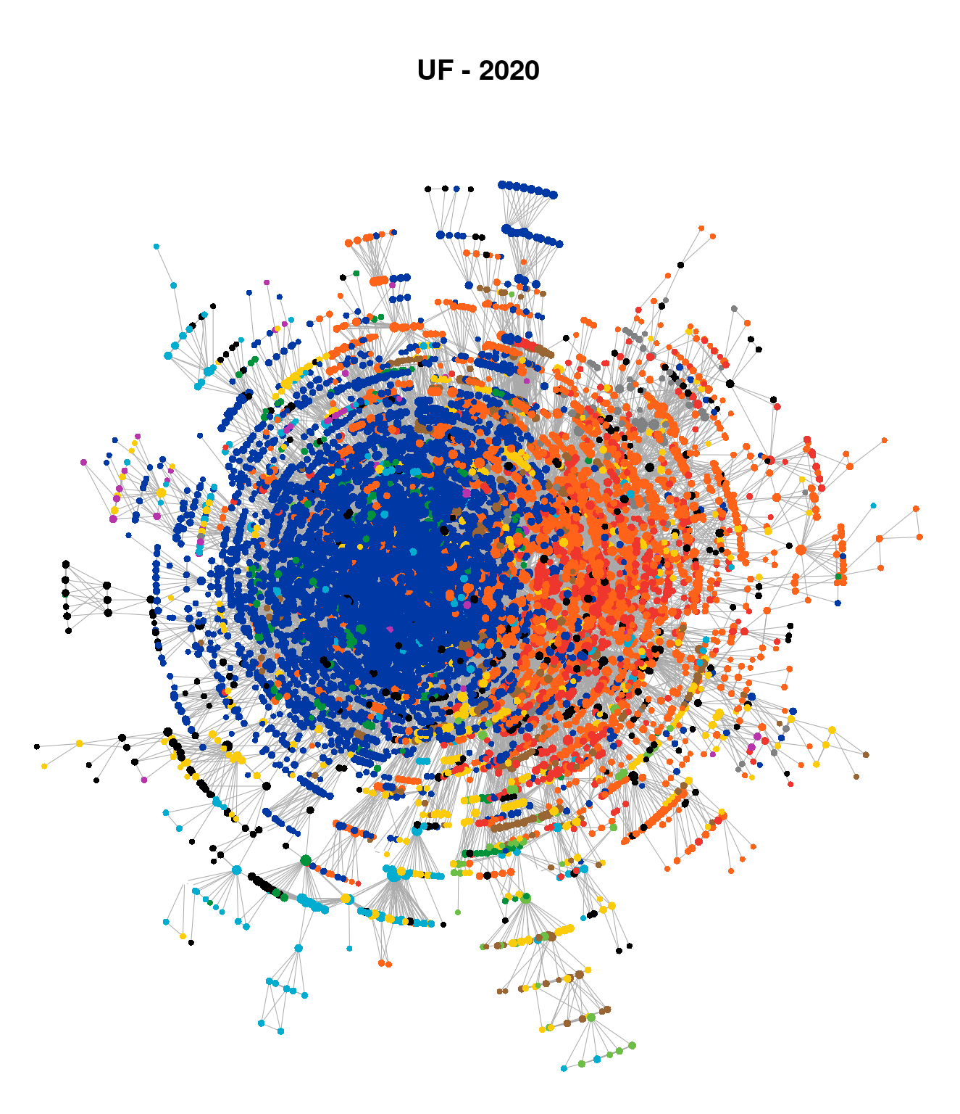
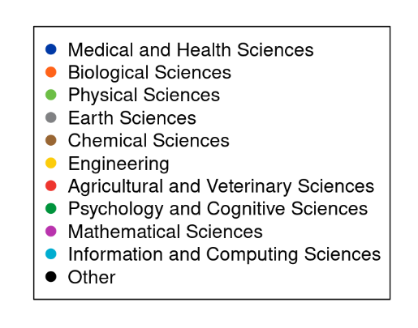
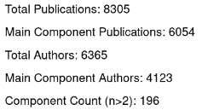
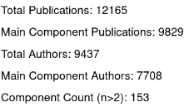
Mapping Florida CTSA Hubs
Network Evolution
University
Of
Florida
(Main Component)
The UF CTSI is supported in part by NIH Clinical and Translational Science Awards UL1TR001427, KL2TR001429 and TL1TR001428.
This content is solely the responsibility of the UF CTSI and does not necessarily represent the official views of the NIH.
Notes:
25

Slide 26
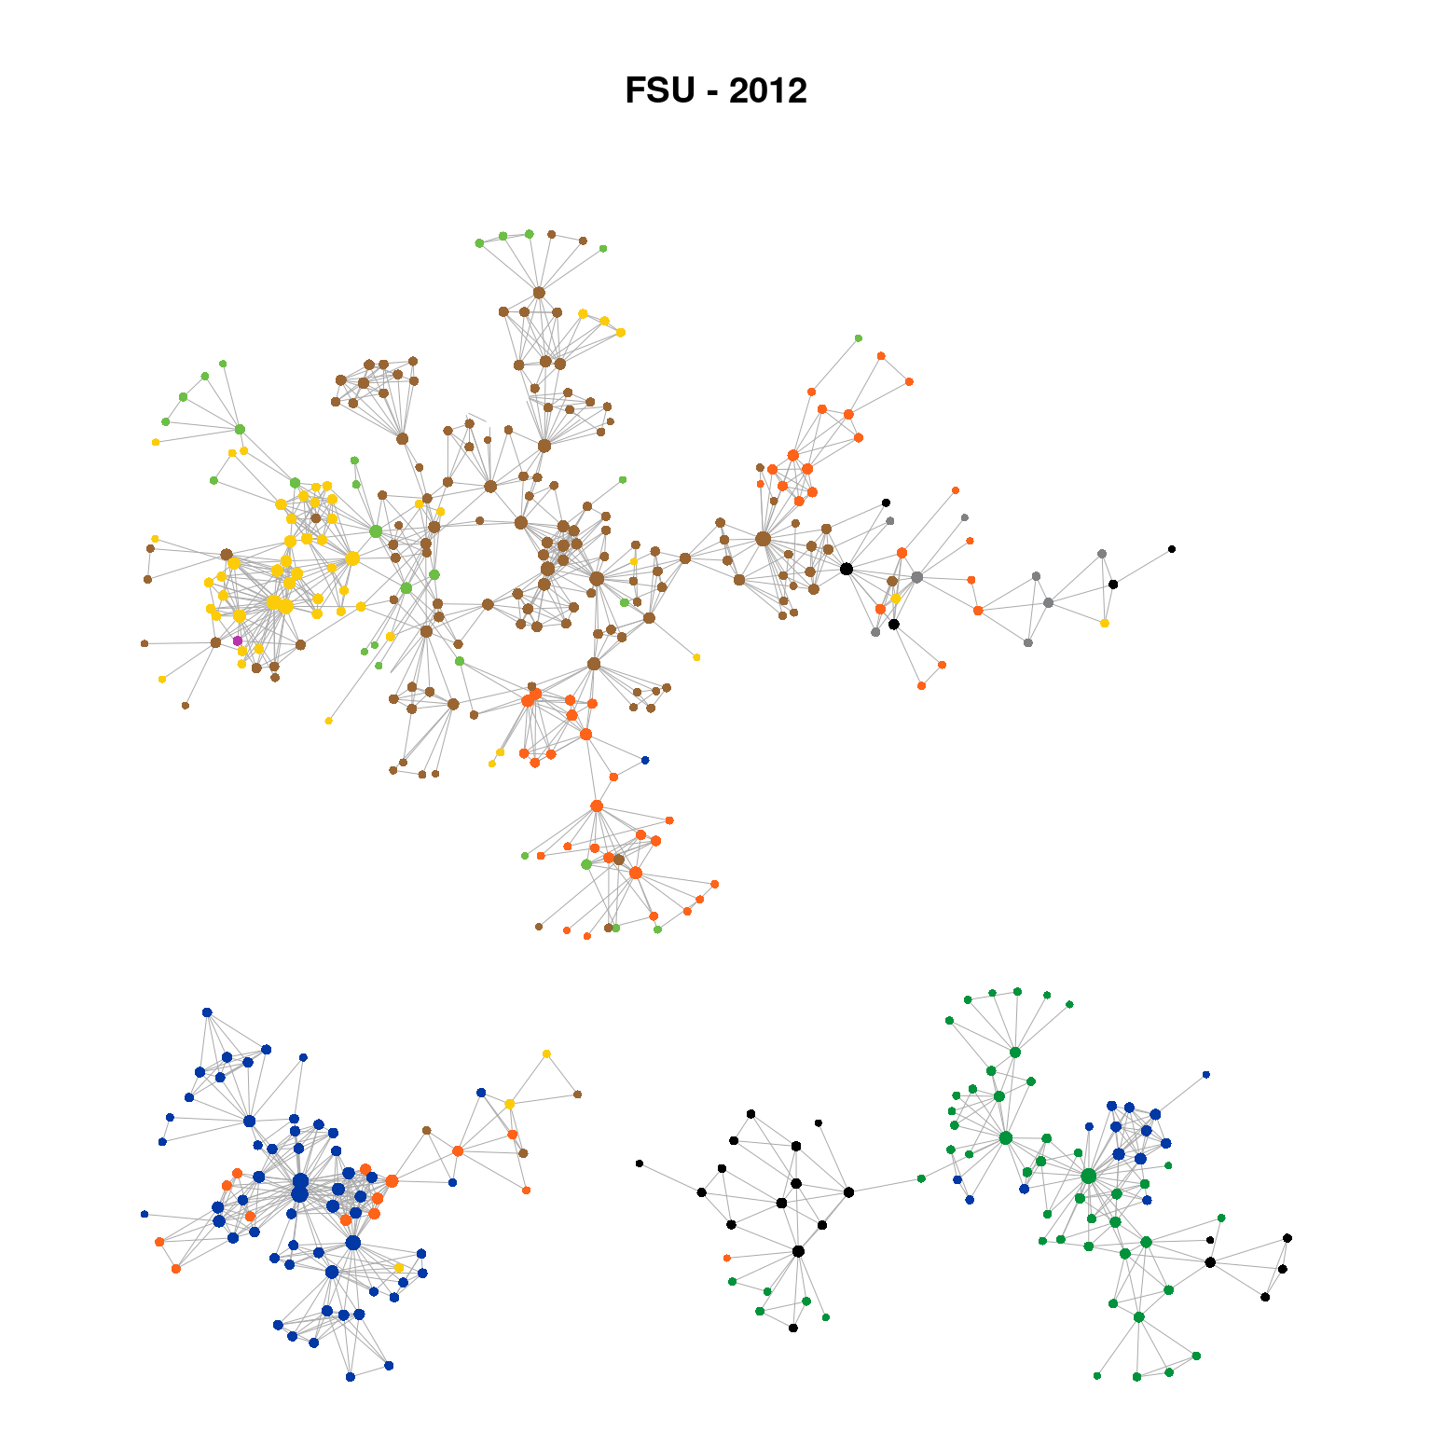
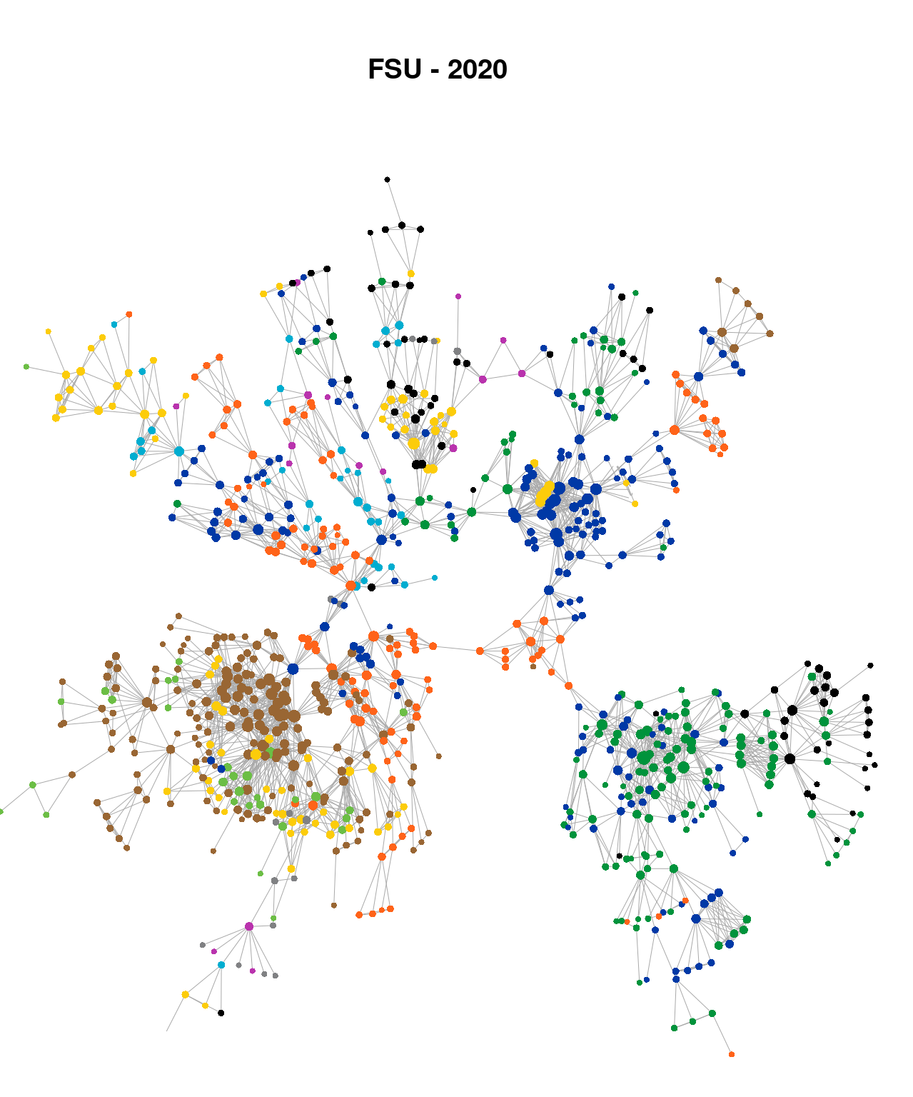
Mapping Florida CTSA Hubs
Network Evolution
Florida
State
University
(Main Components)
The UF CTSI is supported in part by NIH Clinical and Translational Science Awards UL1TR001427, KL2TR001429 and TL1TR001428.
This content is solely the responsibility of the UF CTSI and does not necessarily represent the official views of the NIH.
Notes:
26

Slide 27
Network Interventions
The UF CTSI is supported in part by NIH Clinical and Translational Science Awards UL1TR001427, KL2TR001429 and TL1TR001428.
This content is solely the responsibility of the UF CTSI and does not necessarily represent the official views of the NIH.

Slide 28
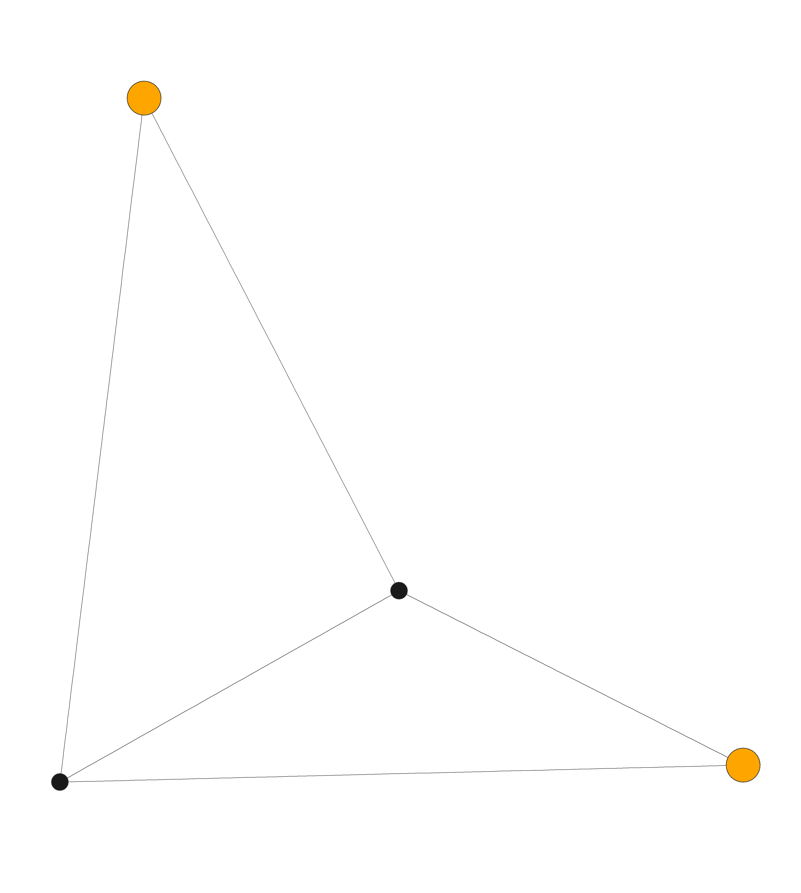
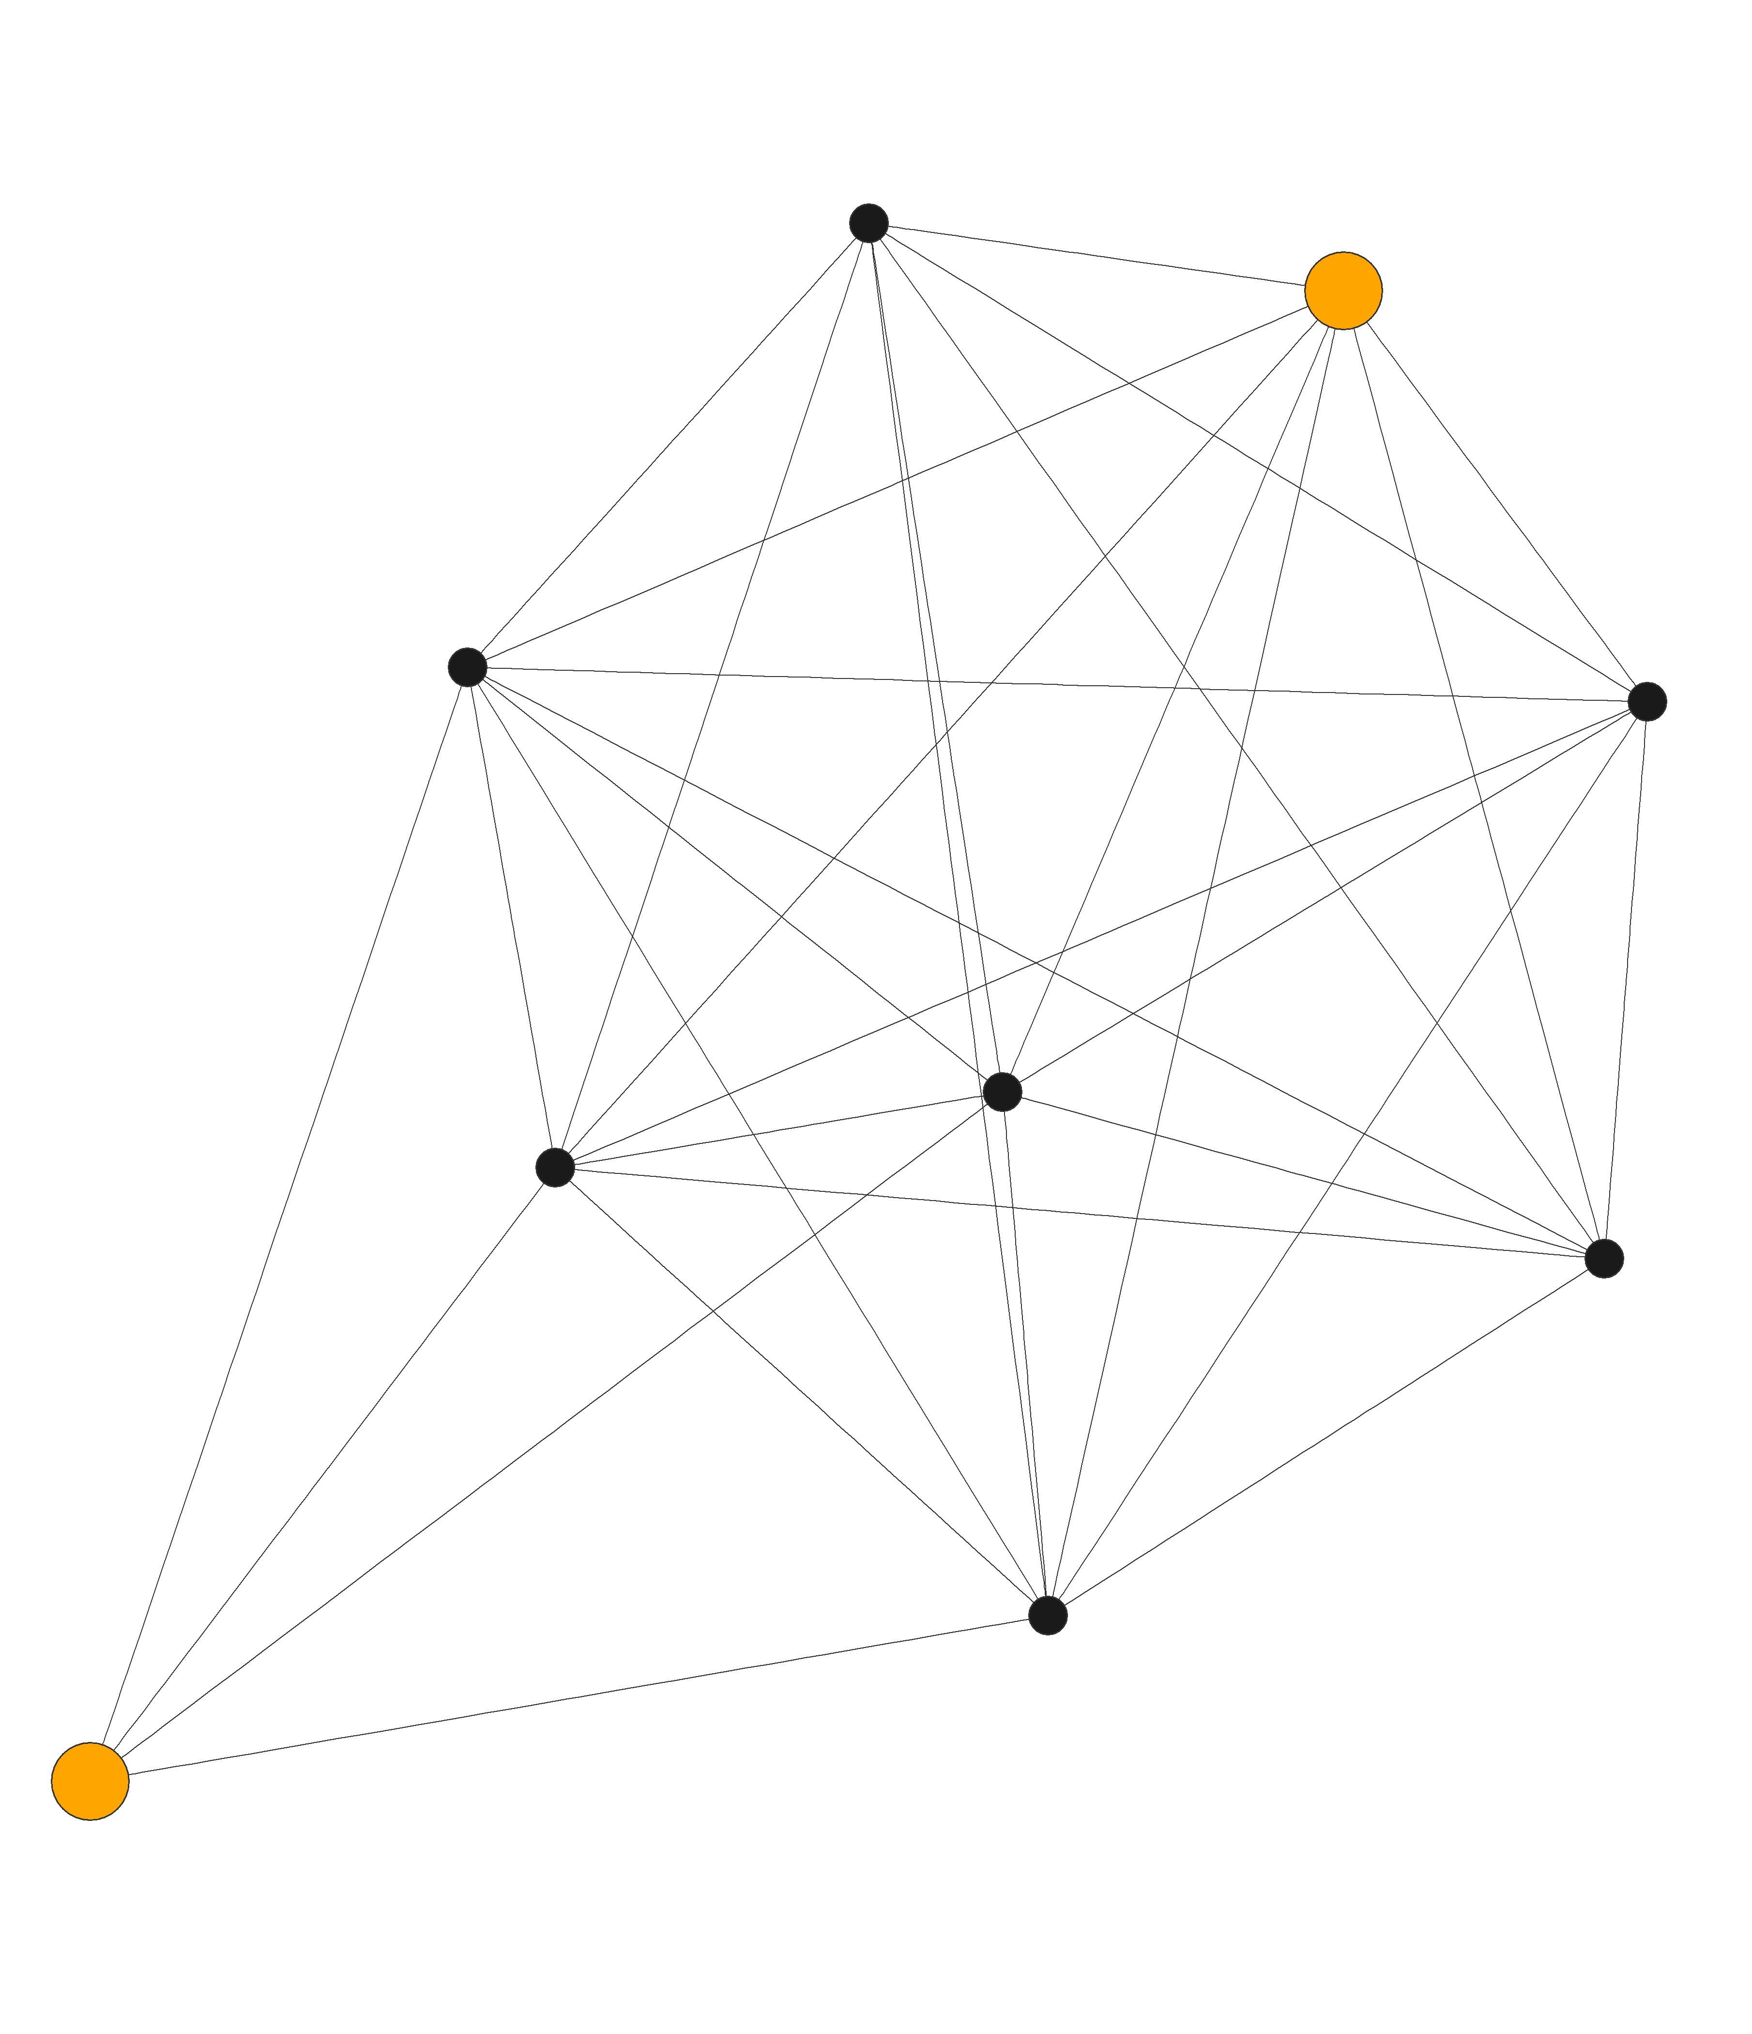
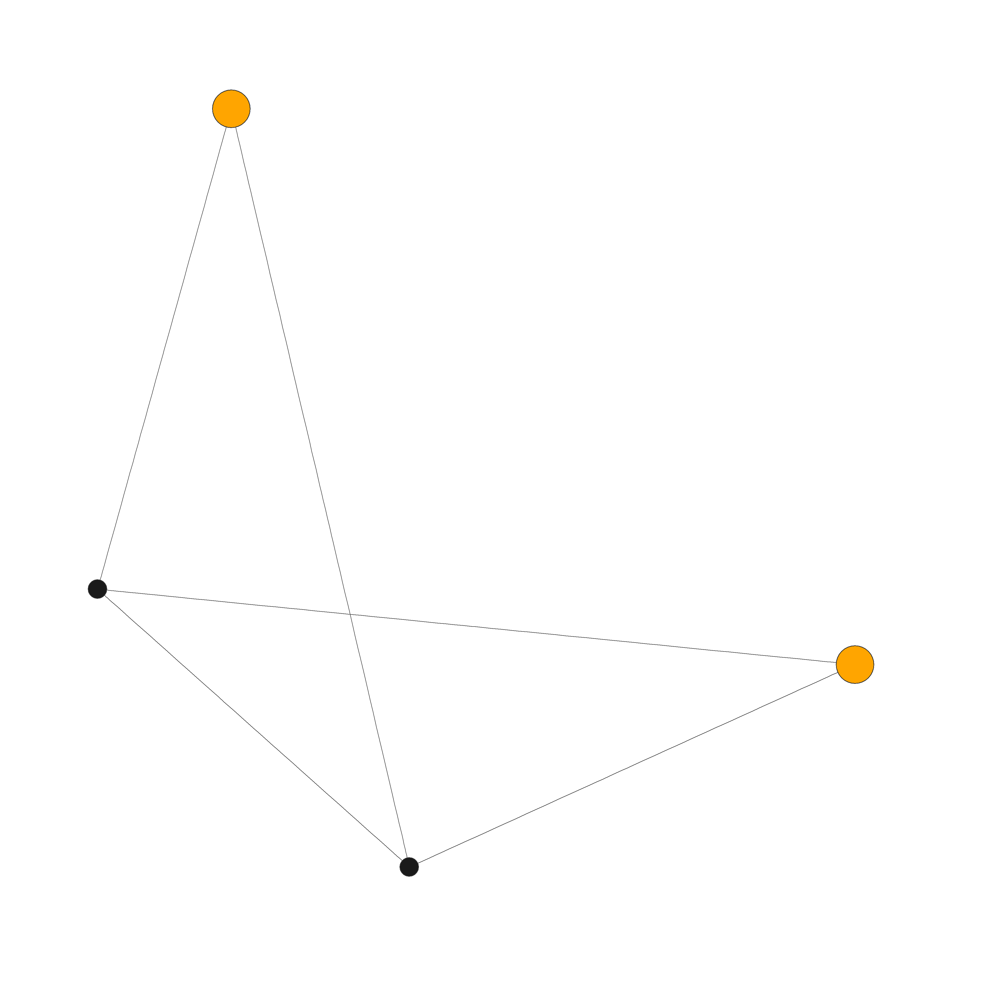
Network Intervention Within UF
Network analysis can inform interventions to
  Promote behavioral change
  Change network
Different network intervention strategies
  Network induction vs alteration
UF Network Interventions Study (2017)
Network alteration
The intervention units: research communities identified via network analysis
new collaborative ties between investigators in the same community who have not worked together in the past
increases structural cohesion of research community
  15 pairs contacted → 8 pairs participated
  5 pairs submitted LOIs
  3 pairs invited to submit full pilot proposals, all granted
Funded Pilots
Strengthens core group: “The development and use of a murine aerosol challenge model for influenza infection to optimize anti-influenza therapeutic regimens” (Co-PIs: Brown and Heine/Institute for Therapeutic Innovation)
Bridges distant areas: “Immunotherapy plus tolerogenic microparticle vaccine combination therapy for Type I Diabetes” (Co-PIs: Haller/COM; Keselowsky/ENG)
Supports project with immediate translational outcome: “Novel approach to reliability and lifetime prediction analysis of dental ceramic materials” (Co-PIs: Esquivel-Upshaw/COD; J. Mecholsky/ENG)
A
C
B
The UF CTSI is supported in part by NIH Clinical and Translational Science Awards UL1TR001427, KL2TR001429 and TL1TR001428.
This content is solely the responsibility of the UF CTSI and does not necessarily represent the official views of the NIH.
Notes:
28

Slide 29
UF Intervention Evaluation Translational Impact
Esquivel-Upshaw (College of Dentistry) and J. Mecholsky (Engineering):
"By being able to identify causes and loads of failure, we can ascertain if the failure was because of material, processing or patient factors. We can then use this information to modify treatment planning models (such as don’t use these crowns in patients that have x condition), alter material composition or modify processing techniques.”
The UF CTSI is supported in part by NIH Clinical and Translational Science Awards UL1TR001427, KL2TR001429 and TL1TR001428.
This content is solely the responsibility of the UF CTSI and does not necessarily represent the official views of the NIH.

Slide 30
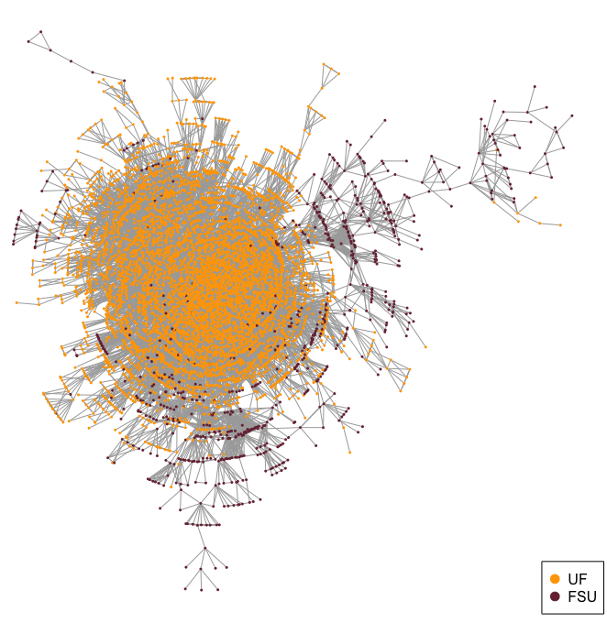
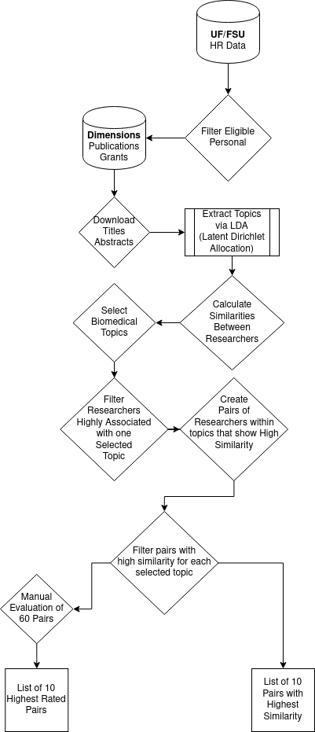
Network Intervention UF-FSU
Topic Model of all publications by UF and FSU researchers from 2018 to 2020.
  Author to author topic similarity score.
Selected biomedical topics that are substantially represented at both universities.
Contacted 20 Pairs
  20 researchers at UF
  20 researchers at FSU
7 Pairs agreed to participate and submitted a Letter of Intent.
Several other candidates were interested, but …
  … had time constraints.
  … corresponding candidate did not reciprocate.
UF ↔ FSU
Publication
Collaboration
Network
The UF CTSI is supported in part by NIH Clinical and Translational Science Awards UL1TR001427, KL2TR001429 and TL1TR001428.
This content is solely the responsibility of the UF CTSI and does not necessarily represent the official views of the NIH.
Notes:
30

Slide 31
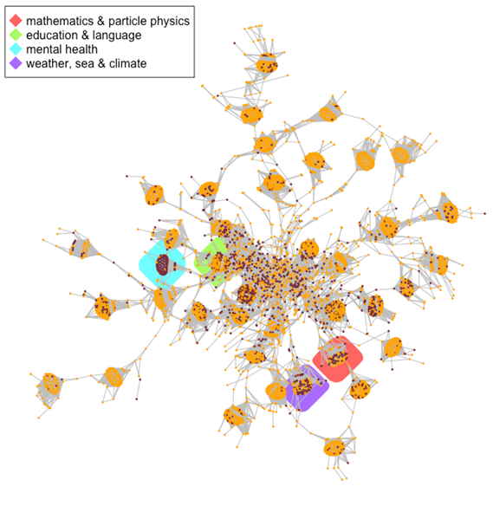
Network Intervention UF-FSU
Topic Model of all publications by UF and FSU researchers from 2018 to 2020.
  Author to author topic similarity score.
Selected biomedical topics that are substantially represented at both universities.
Contacted 20 Pairs
  20 researchers at UF
  20 researchers at FSU
7 Pairs agreed to participate and submitted a Letter of Intent.
Several other candidates were interested, but …
  … had time constraints.
  … corresponding candidate did not reciprocate.
UF ↔ FSU
Topic Similarity
Network
The UF CTSI is supported in part by NIH Clinical and Translational Science Awards UL1TR001427, KL2TR001429 and TL1TR001428.
This content is solely the responsibility of the UF CTSI and does not necessarily represent the official views of the NIH.

Slide 32
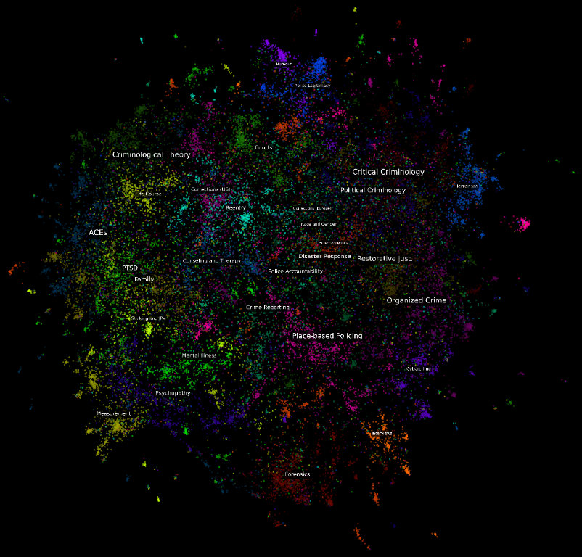
Mapping Research Landscapes with Modern Topic Models
Natural Language Processing
  Interdisciplinary subfield of linguistics and computer science (artificial intelligence and machine learning).
  Concerned with the computational interpretation and processing of human text and speech.
What do we want?
  A numeric representation of each word, document (or author), and topic.
How can this be achieved?
  Self-supervised topic modelling.
    Word2Vec (Word-to-Vector)
    Doc2Vec (Document-to-Vector)
    Top2Vec (Topic-to-Vector)
Example:
Criminology and Criminal Justice (2000 – 2021)
The UF CTSI is supported in part by NIH Clinical and Translational Science Awards UL1TR001427, KL2TR001429 and TL1TR001428.
This content is solely the responsibility of the UF CTSI and does not necessarily represent the official views of the NIH.

Slide 33
Evolution of Collaboration at ASU and UF
The UF CTSI is supported in part by NIH Clinical and Translational Science Awards UL1TR001427, KL2TR001429 and TL1TR001428.
This content is solely the responsibility of the UF CTSI and does not necessarily represent the official views of the NIH.

Slide 34
Background
Michael Crow became president of ASU in 2002
His most well-known intervention was the reorganization of departments and colleges into problem focused schools
There were two reasons for this:
The most widely know reason was to break down disciplinary silos and incentivize interdisciplinary collaboration
Less know was the creation of administrative efficiency and elimination of redundant departments and curricula across ASU campuses.
This has been described as making ASU one university in multiple campuses rather than many universities across campuses
The UF CTSI is supported in part by NIH Clinical and Translational Science Awards UL1TR001427, KL2TR001429 and TL1TR001428.
This content is solely the responsibility of the UF CTSI and does not necessarily represent the official views of the NIH.

Slide 35
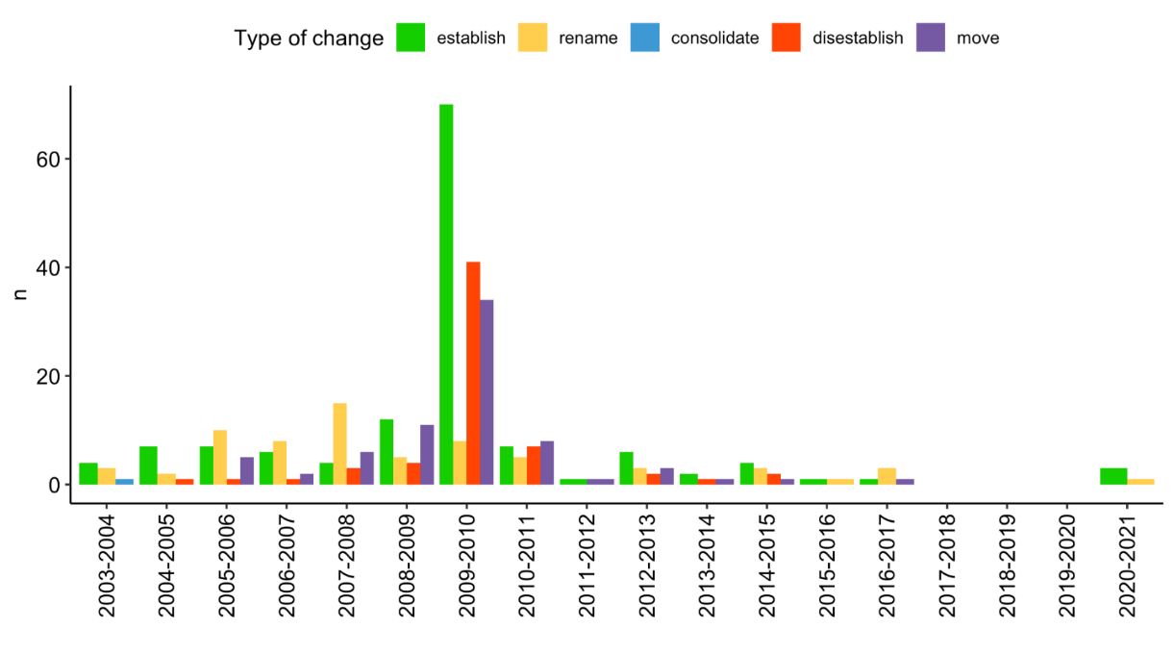
Timeline
The UF CTSI is supported in part by NIH Clinical and Translational Science Awards UL1TR001427, KL2TR001429 and TL1TR001428.
This content is solely the responsibility of the UF CTSI and does not necessarily represent the official views of the NIH.

Slide 36
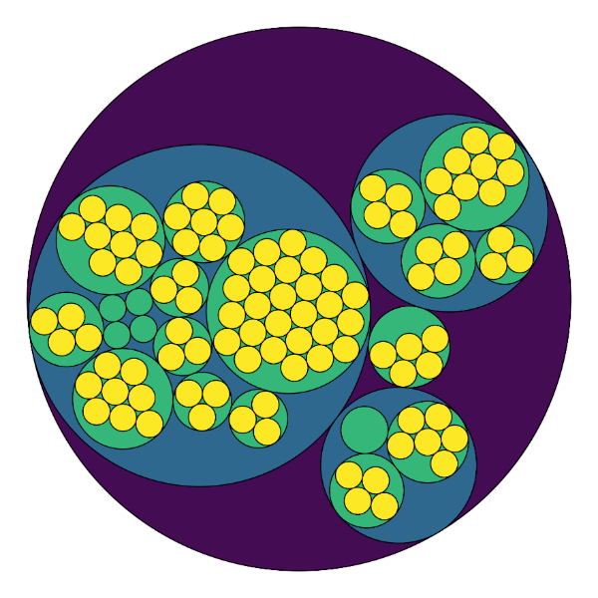
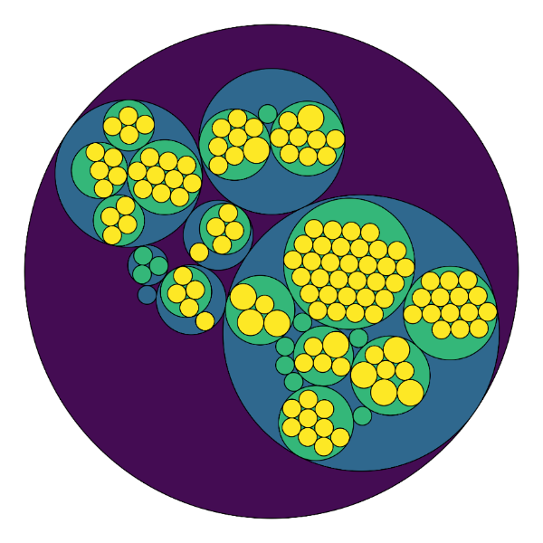
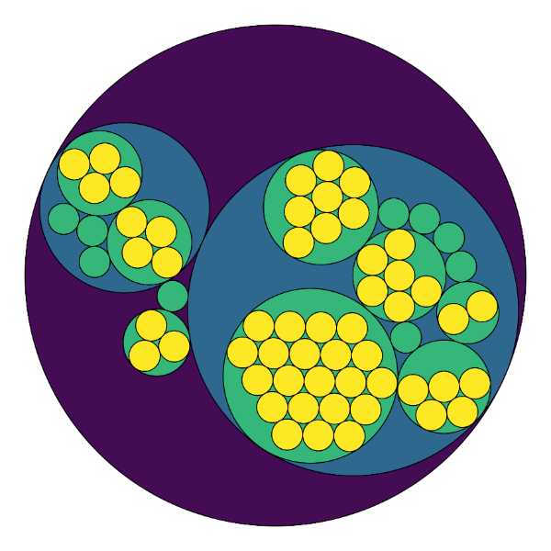
Background
2002-2003
Colleges/Schools 21
Departments/Schools 103
2009-2010
Colleges/Schools 25
Departments/Schools 123
2018-2019
Colleges/Schools 17
Departments/Schools 61
The UF CTSI is supported in part by NIH Clinical and Translational Science Awards UL1TR001427, KL2TR001429 and TL1TR001428.
This content is solely the responsibility of the UF CTSI and does not necessarily represent the official views of the NIH.

Slide 37
Data Source: Dimensions
100 million publication records (import from CrossRef and public sources like PubMED etc.)
4.8 million awarded grants (ingest information from FedReporter and similar interfaces)
38 million patent records
460,000 clinical trials
420,000 policy documents
…
The UF CTSI is supported in part by NIH Clinical and Translational Science Awards UL1TR001427, KL2TR001429 and TL1TR001428.
This content is solely the responsibility of the UF CTSI and does not necessarily represent the official views of the NIH.

Slide 38
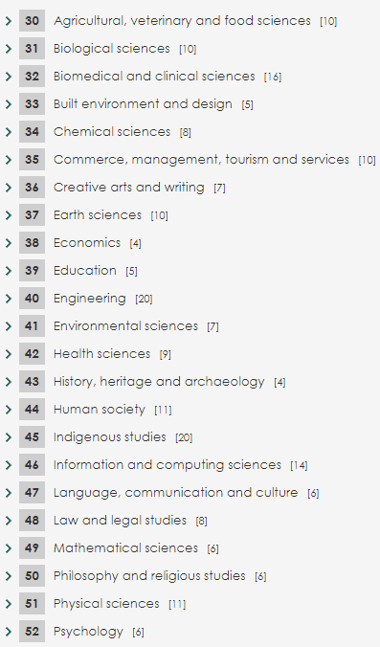
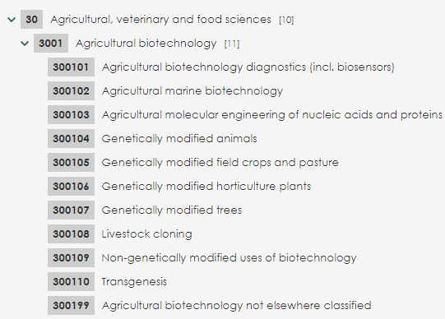
Data Source: Dimensions
Fields of Research (FoR)
  Hierarchical categorization system with three levels
    L1: Divisions
    L2: Groups
    L3: Field
  FoR codes are part of The Australian and New Zealand Standard Research Classification (ANZSRC) system
Units of Assessment (UoA)
  36 Units/Disciplines
  UoAs are part of the UK Research Excellence Framework (REF 2014)
Three levels of FoR Codes for Agriculture
FoR Codes: Divisions
The UF CTSI is supported in part by NIH Clinical and Translational Science Awards UL1TR001427, KL2TR001429 and TL1TR001428.
This content is solely the responsibility of the UF CTSI and does not necessarily represent the official views of the NIH.

Slide 39
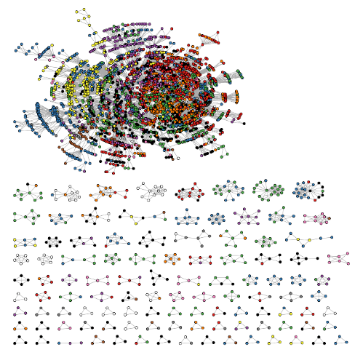
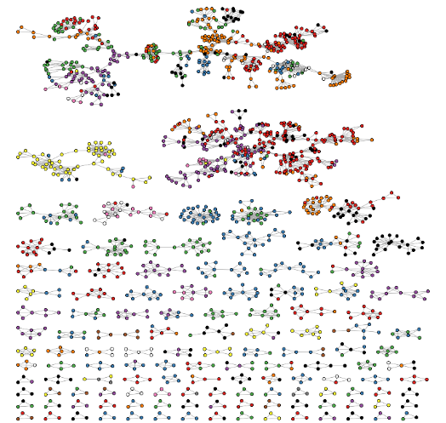
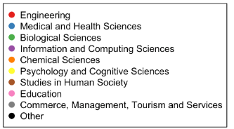
Cross Section vs. Backbone Network
Cross Section Network:
All co-authorships in a specific time frame (i.e., 3 years) are represented as network ties.
Backbone Network:
Only repeated co-authorships in a specific time frame are represented as network ties. For example, at least 2 collaborations over a period of 3 years.
ASU Cross Section Network 2009-2011
ASU Backbone Network 2009-2011
The UF CTSI is supported in part by NIH Clinical and Translational Science Awards UL1TR001427, KL2TR001429 and TL1TR001428.
This content is solely the responsibility of the UF CTSI and does not necessarily represent the official views of the NIH.

Slide 40
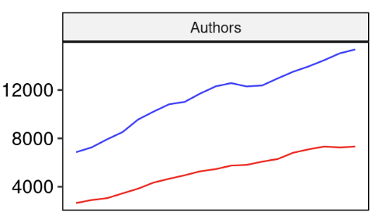
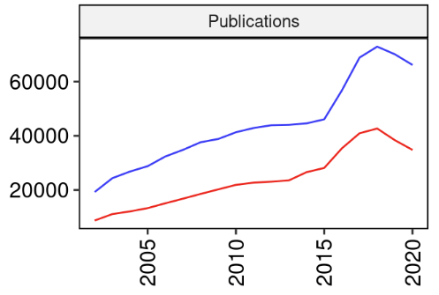
Authors and Publications
Both UF and ASU are growing.
However, UF tends to have twice as many publishing researchers in any given year.
Besides this difference in volume, the growth in both authors and their publications at both institutions has been comparable.
The UF CTSI is supported in part by NIH Clinical and Translational Science Awards UL1TR001427, KL2TR001429 and TL1TR001428.
This content is solely the responsibility of the UF CTSI and does not necessarily represent the official views of the NIH.

Slide 41
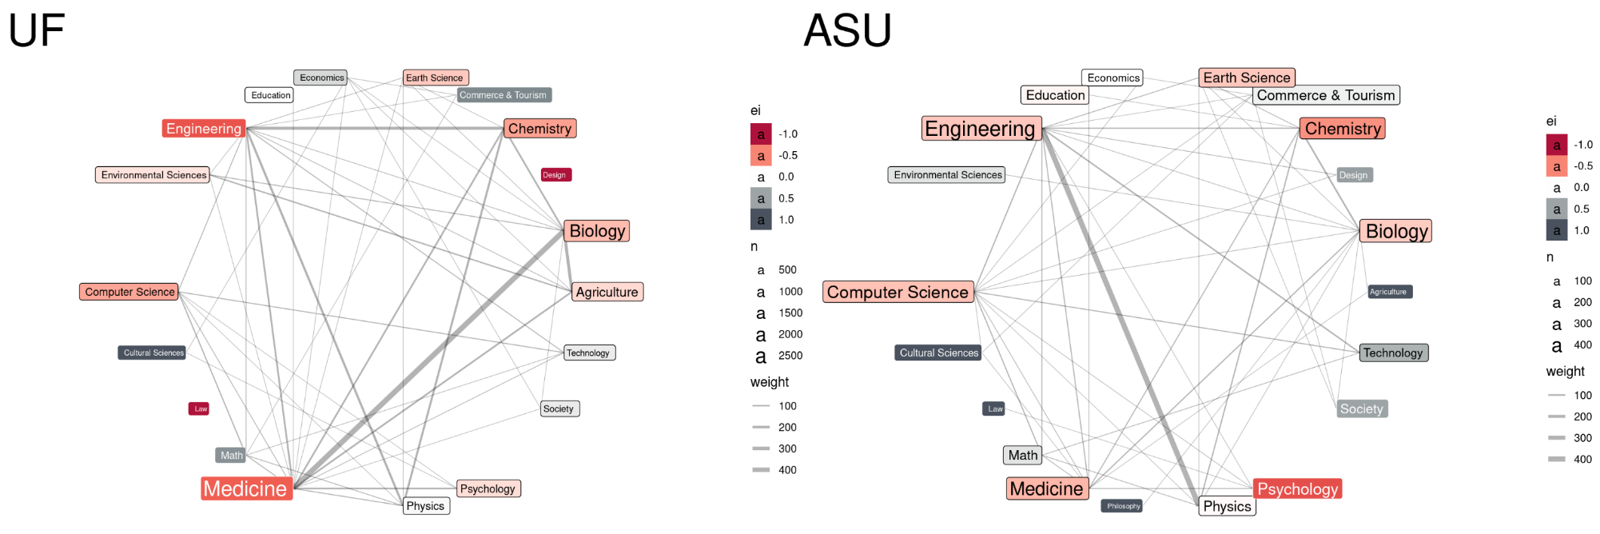
Inter- and Intradisciplinary Collaboration 2000-2002
The UF CTSI is supported in part by NIH Clinical and Translational Science Awards UL1TR001427, KL2TR001429 and TL1TR001428.
This content is solely the responsibility of the UF CTSI and does not necessarily represent the official views of the NIH.

Slide 42
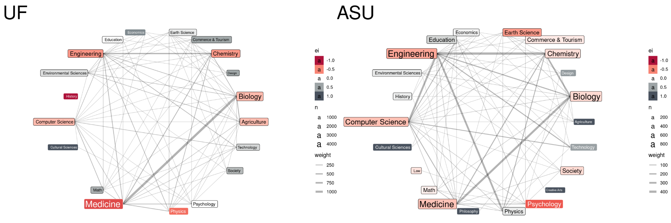
Inter- and Intradisciplinary Collaboration 2009-2011
The UF CTSI is supported in part by NIH Clinical and Translational Science Awards UL1TR001427, KL2TR001429 and TL1TR001428.
This content is solely the responsibility of the UF CTSI and does not necessarily represent the official views of the NIH.

Slide 43
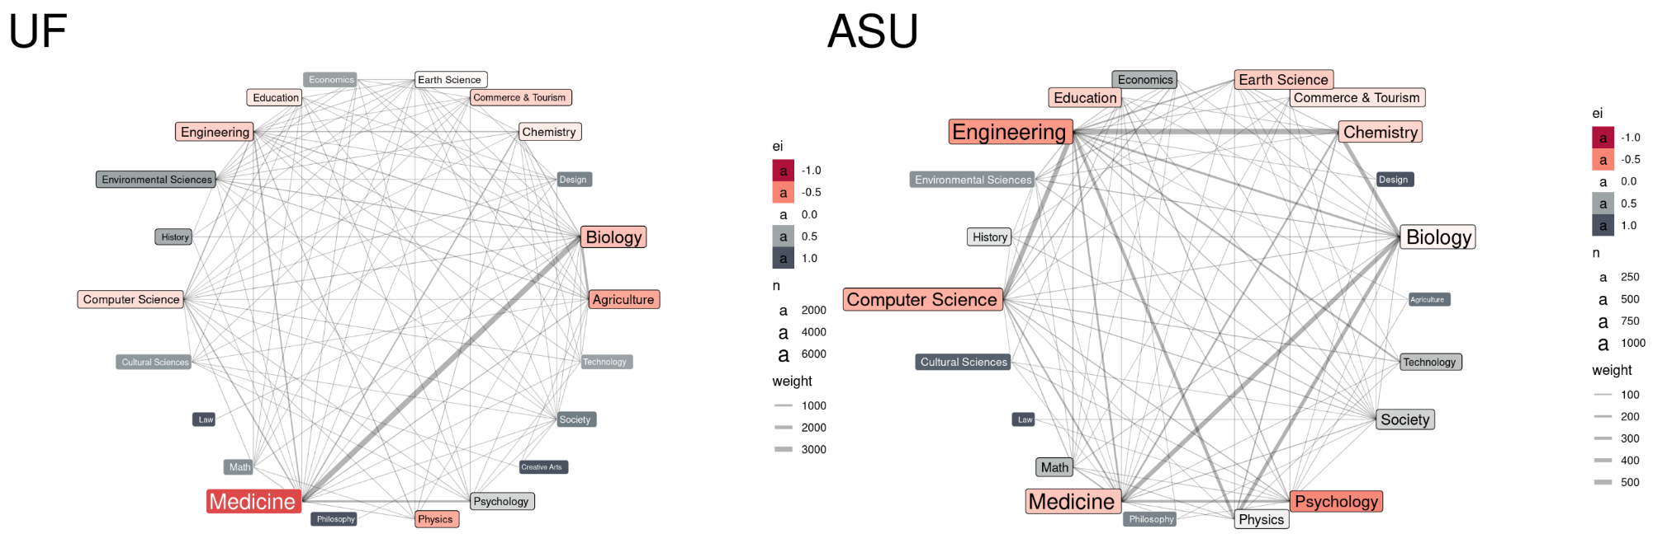
Inter- and Intradisciplinary Collaboration 2018-2020
The UF CTSI is supported in part by NIH Clinical and Translational Science Awards UL1TR001427, KL2TR001429 and TL1TR001428.
This content is solely the responsibility of the UF CTSI and does not necessarily represent the official views of the NIH.

Slide 44
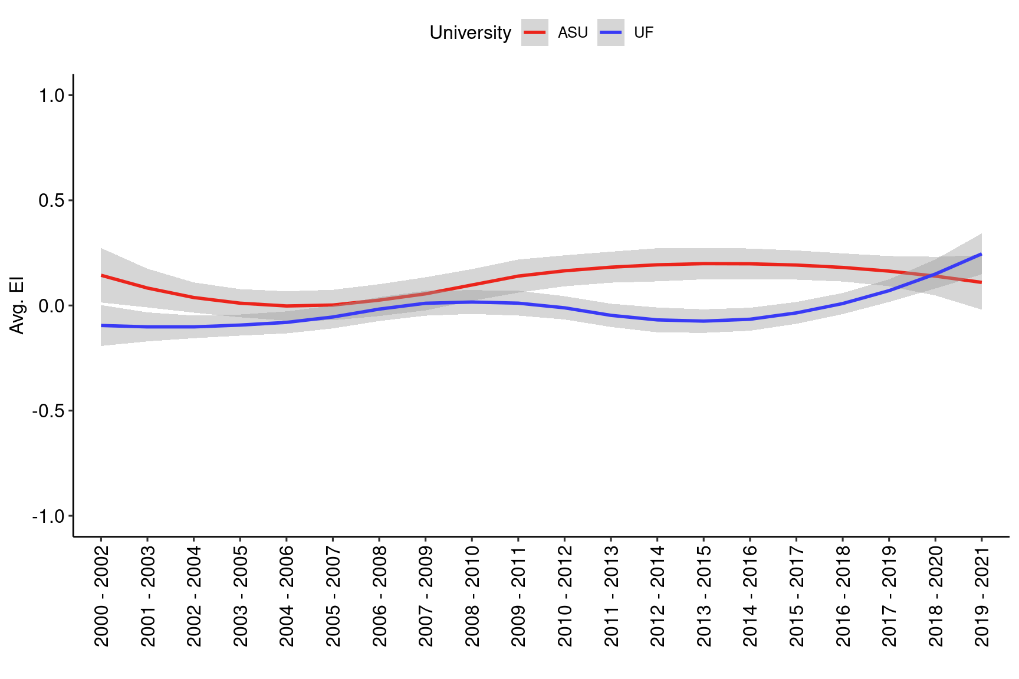
Interdisciplinary Collaboration
FoR Divisions
In recent years, ASU appears to have become more collaborative, trending more towards interdisciplinary ties.
However, this is only part of the picture.
We also need to explore the distribution of disciplines across research communities.
The UF CTSI is supported in part by NIH Clinical and Translational Science Awards UL1TR001427, KL2TR001429 and TL1TR001428.
This content is solely the responsibility of the UF CTSI and does not necessarily represent the official views of the NIH.

Slide 45
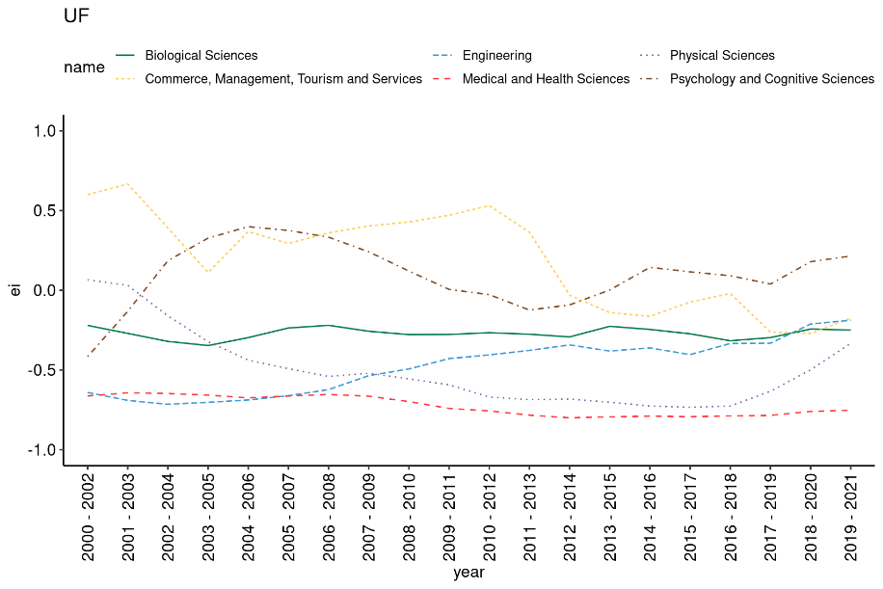
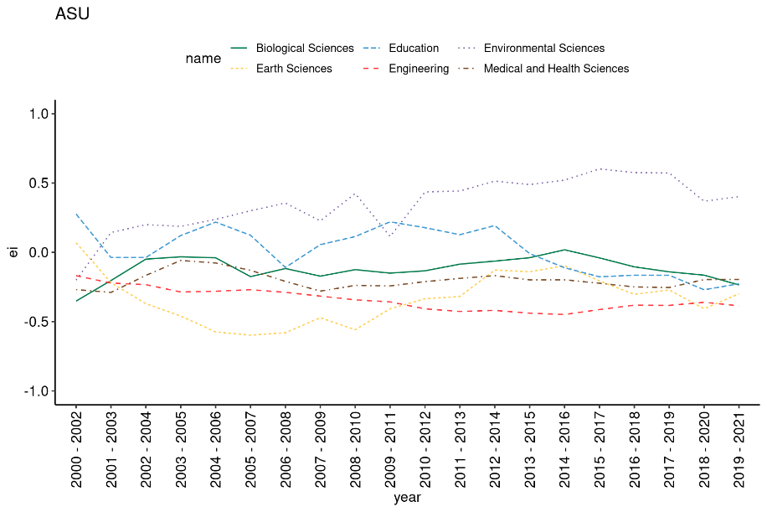
Changes in Interdisciplinary Activity
EI-index
The UF CTSI is supported in part by NIH Clinical and Translational Science Awards UL1TR001427, KL2TR001429 and TL1TR001428.
This content is solely the responsibility of the UF CTSI and does not necessarily represent the official views of the NIH.

Slide 46
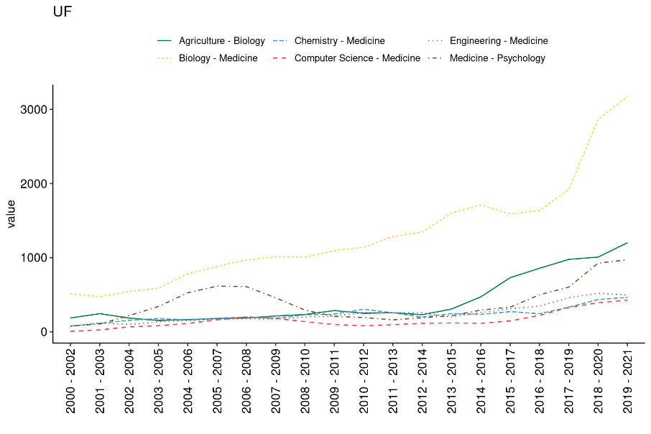
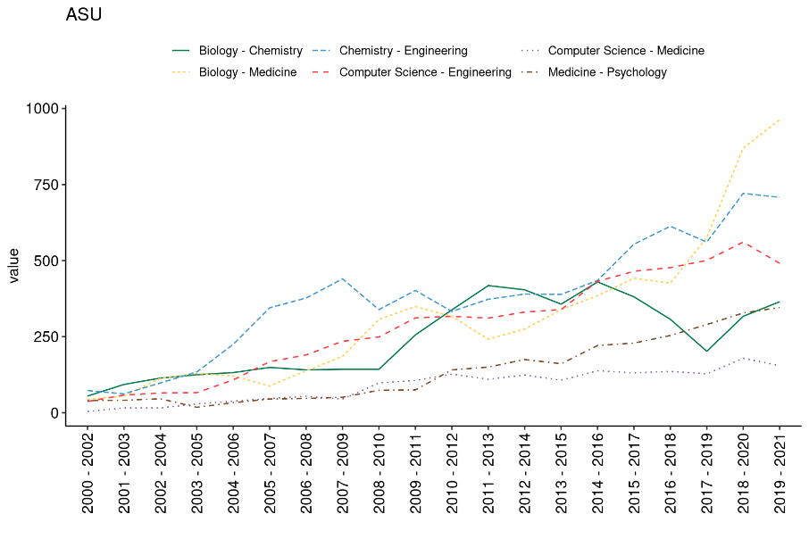
Changes in Interdisciplinary Activity
Tie-level
The UF CTSI is supported in part by NIH Clinical and Translational Science Awards UL1TR001427, KL2TR001429 and TL1TR001428.
This content is solely the responsibility of the UF CTSI and does not necessarily represent the official views of the NIH.

Slide 47


Co-authorship Publication Network

Slide 48


Co-authorship Publication Network

Slide 49


Co-authorship Publication Network

Slide 50

Collaboration Network Structure
UF and ASU networks are growing,
with additional
scholars (nodes) and,
by extension,
collaborations (edges).
Proportion of extant collaborations relative to possible collaborations (edge density) is decreasing as the number of scholars grows.
However, the tendency to collaborate only with friends-of-friends (transitivity) is decreasing.
Scholars at both institutions are becoming closer to the rest of their colleagues.
The UF CTSI is supported in part by NIH Clinical and Translational Science Awards UL1TR001427, KL2TR001429 and TL1TR001428.
This content is solely the responsibility of the UF CTSI and does not necessarily represent the official views of the NIH.

Slide 51

Publication Interdisciplinarity
A naïve measure of interdisciplinarity, we count the number of discipline classifications on each publication attributed to each institution.
UF’s medical school sub-disciplines intersect more frequently.
On average, ASU and UF tend to be associated with a similar number of classifications.
ASU publications are slightly more interdisciplinary across all disciplines (Fields of Research, Units of Assessment).
The UF CTSI is supported in part by NIH Clinical and Translational Science Awards UL1TR001427, KL2TR001429 and TL1TR001428.
This content is solely the responsibility of the UF CTSI and does not necessarily represent the official views of the NIH.

Slide 52

Authorial Interdisciplinarity
Authorial interdisciplinarity at ASU and UF tells a similar story as publication interdisciplinarity.
On average, ASU and UF authors are affiliated very similar when measured via Unit of Assessment.
As before, ASU authors intersect Fields of Research more frequently, but UF authors intersect Health Research Classifications more frequently.
The UF CTSI is supported in part by NIH Clinical and Translational Science Awards UL1TR001427, KL2TR001429 and TL1TR001428.
This content is solely the responsibility of the UF CTSI and does not necessarily represent the official views of the NIH.

Slide 53

Describing our Research Communities
Network communities were detected with Louvain method.
Communities are clusters of densely connected nodes (relative to rest of network).
ASU tends to have fewer network communities.
ASU network communities tend to be smaller than UF network communities.
ASU’s Stable network community modularity could suggest that ASU’s reorganization has allowed researchers to more easily assort themselves into the research community, or communities which best suit their agenda.
The UF CTSI is supported in part by NIH Clinical and Translational Science Awards UL1TR001427, KL2TR001429 and TL1TR001428.
This content is solely the responsibility of the UF CTSI and does not necessarily represent the official views of the NIH.

Slide 54

Community Interdisciplinarity
The UF CTSI is supported in part by NIH Clinical and Translational Science Awards UL1TR001427, KL2TR001429 and TL1TR001428.
This content is solely the responsibility of the UF CTSI and does not necessarily represent the official views of the NIH.

Slide 55


Research Community Stability and Reorganization
Correlated with the period of institutional reorganization, ASU’s research communities have begun reorganizing at a greater rate over time (through a combination of gaining new collaborators, losing old collaborators, splitting into sub-communities, and merging into broader communities).
UF communities reorganize consistently at a greater rate. However, this is likely due to having more researchers.
The UF CTSI is supported in part by NIH Clinical and Translational Science Awards UL1TR001427, KL2TR001429 and TL1TR001428.
This content is solely the responsibility of the UF CTSI and does not necessarily represent the official views of the NIH.

Slide 56



Research Community Stability and Reorganization
Case Study: School of Sustainability
2000 - 2002
2010 - 2012
2015 - 2017
The UF CTSI is supported in part by NIH Clinical and Translational Science Awards UL1TR001427, KL2TR001429 and TL1TR001428.
This content is solely the responsibility of the UF CTSI and does not necessarily represent the official views of the NIH.

Slide 57

Research Community Stability and Reorganization
Case Study: School of Sustainability
2000 - 2002
2015 - 2017
The UF CTSI is supported in part by NIH Clinical and Translational Science Awards UL1TR001427, KL2TR001429 and TL1TR001428.
This content is solely the responsibility of the UF CTSI and does not necessarily represent the official views of the NIH.

Slide 58
Conclusions
Both ASU and UF are growing in size and interdisciplinarity..
Comparisons between ASU and UF are difficult due to the differences in size and disciplinary focus
ASU’s smaller disciplines became more collaborative.
  Additionally, Biology and Medicine have intensified their collaborative relationship.
ASU has become increasingly interdisciplinary since 2002 – often more so than UF.
Despite its increasing size, ASU has remained modular. This could be thanks to the elimination of boundaries between authors who should be working on similar, modern research areas.
The UF CTSI is supported in part by NIH Clinical and Translational Science Awards UL1TR001427, KL2TR001429 and TL1TR001428.
This content is solely the responsibility of the UF CTSI and does not necessarily represent the official views of the NIH.

Slide 59
Questions for the Workshop
What is the vision for future patterns of interdisciplinarity
Would ASU benefit if other universities adopted the same boundaries or reorganized into different boundaries?
You can’t cross disciplines that don’t exist. Does ASU benefit from disciplines being maintained at other universities?
The UF CTSI is supported in part by NIH Clinical and Translational Science Awards UL1TR001427, KL2TR001429 and TL1TR001428.
This content is solely the responsibility of the UF CTSI and does not necessarily represent the official views of the NIH.

